Slide 1
data
storytelling
101
William Andrew G. Bulaqueña
Notes:
Information age, With the increase of technology, comes the increase in data and tools to work with it.
don’t be data fashion victim, simple beats sexy

Slide 2
bad graphs are everywhere
Notes:
I have encountered a lot of confusing visuals at work.
Even those tasked with data analysis and visualization are guilty of this

Slide 3
we’ll shift from
simply showing data to storytelling with data

Slide 4
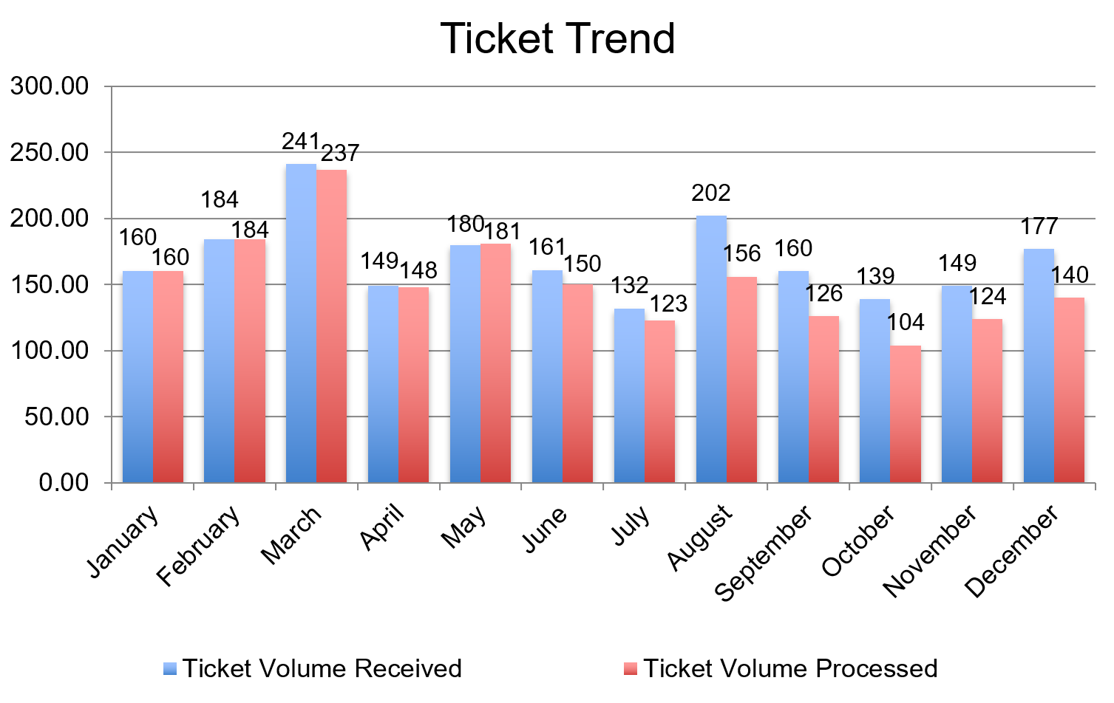
what to expect?
example 1 (before): showing data

Slide 5
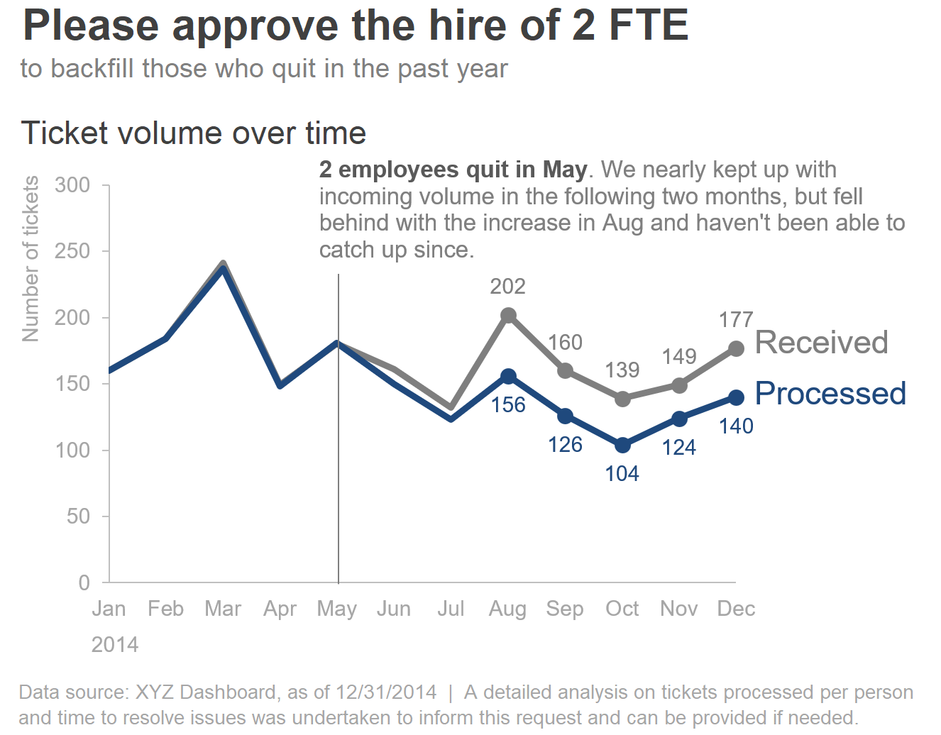
what to expect?
example 1 (after): storytelling with data

Slide 6
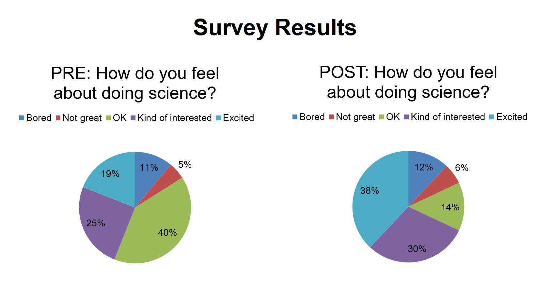
what to expect?
example 2 (before): showing data

Slide 7
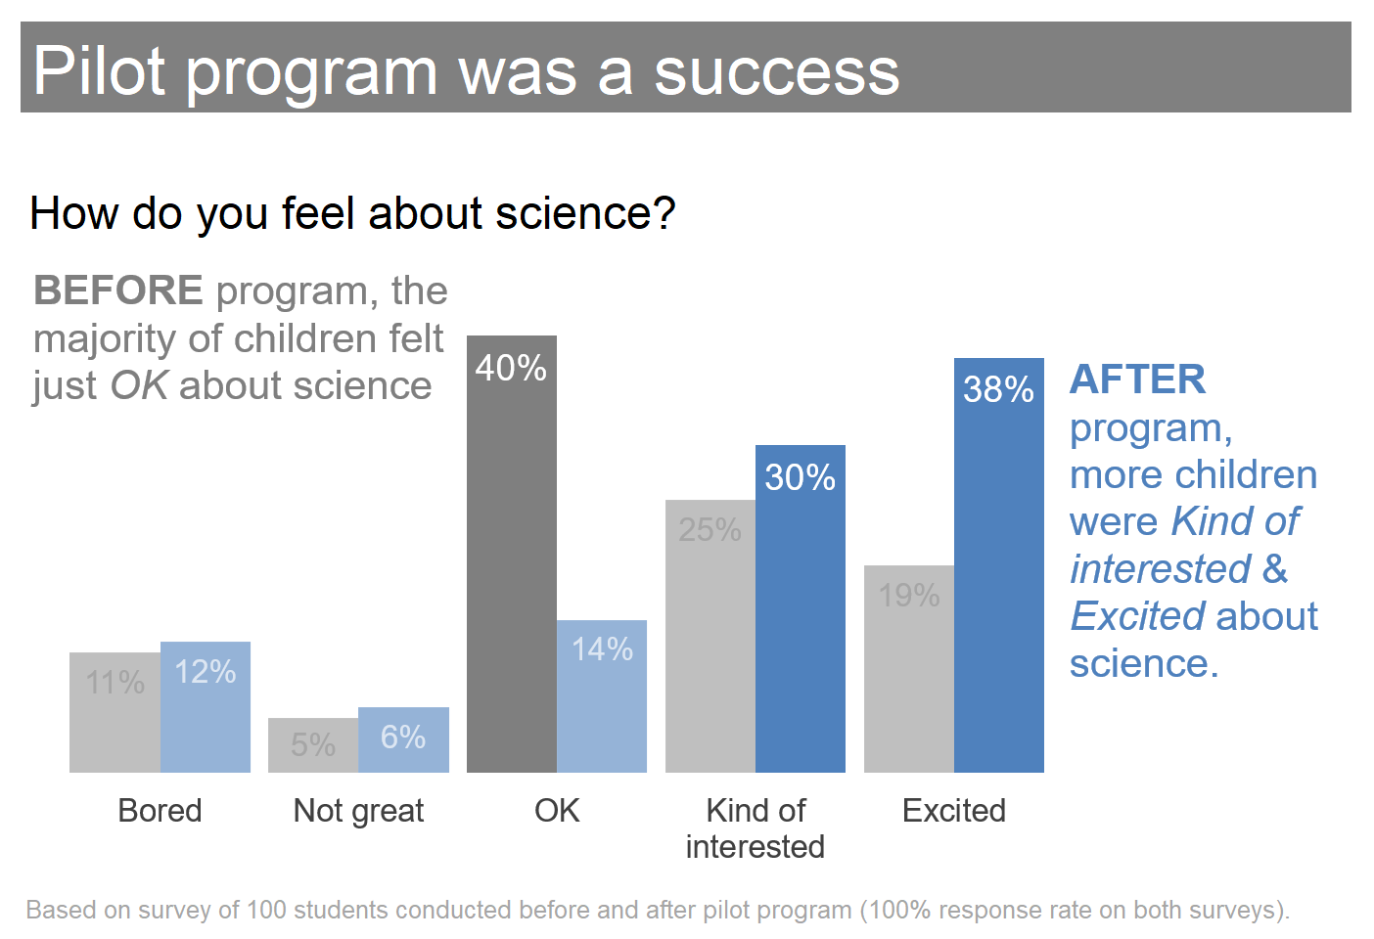
what to expect?
example 2 (after): storytelling with data

Slide 8
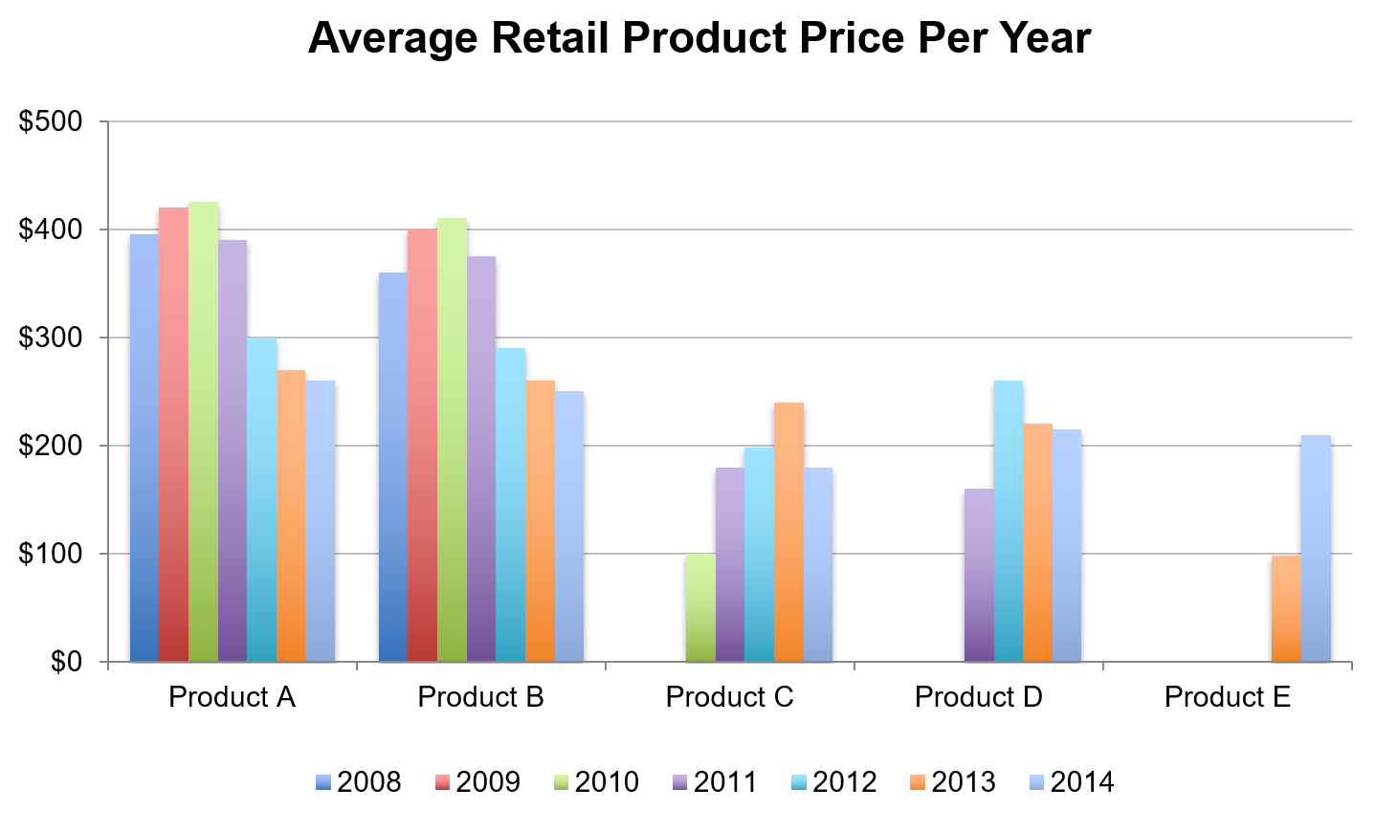
what to expect?
example 3 (before): showing data

Slide 9
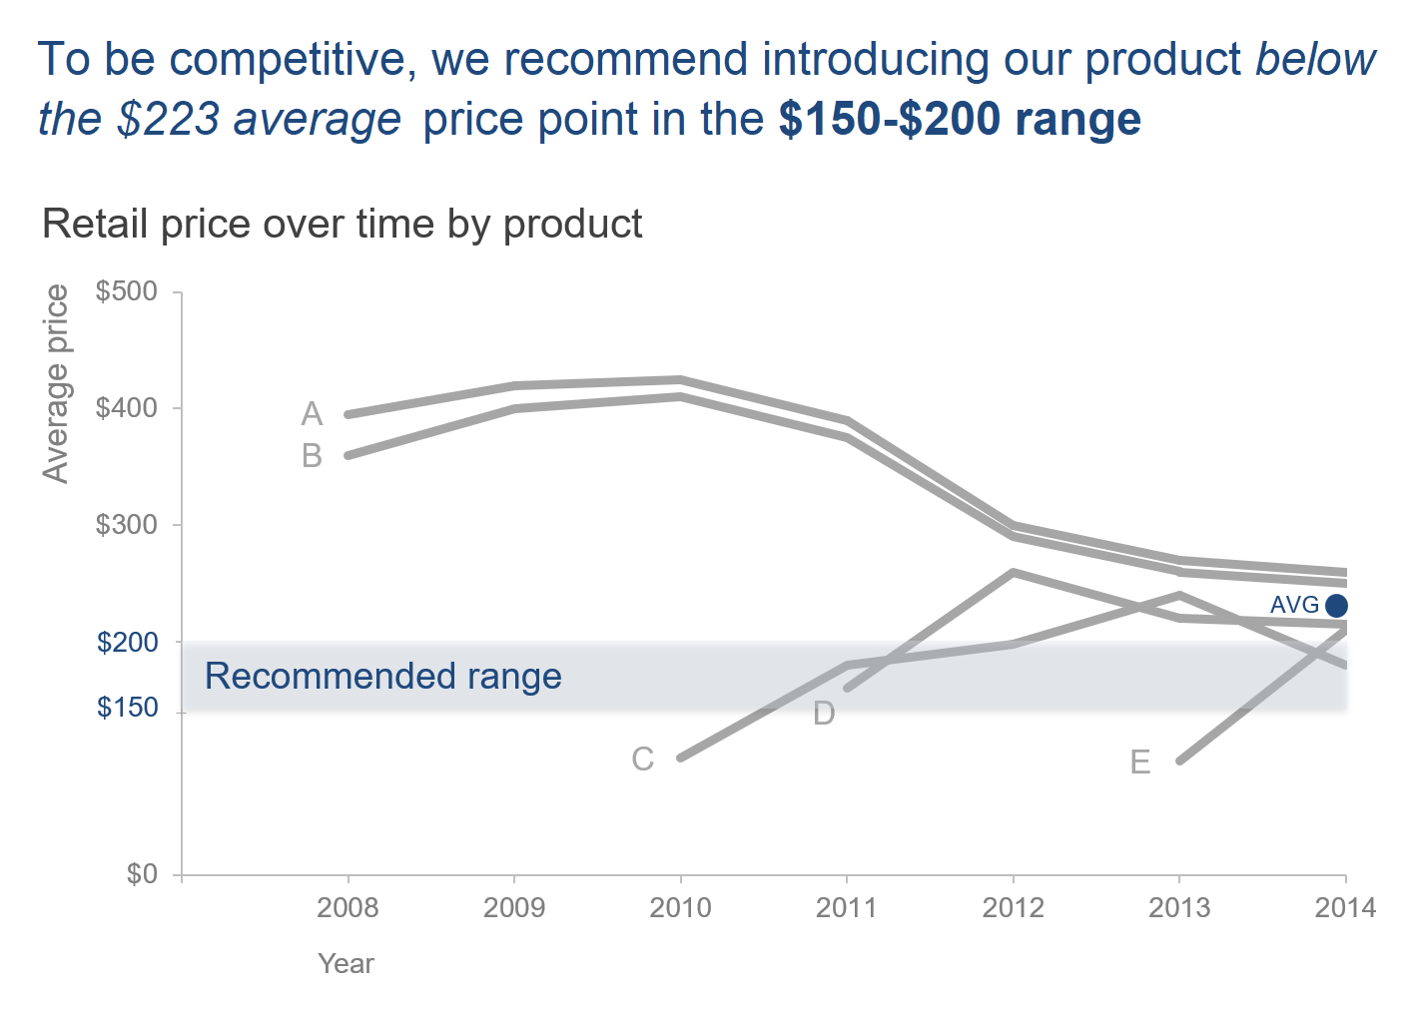
what to expect?
example 3 (before): storytelling with data

Slide 10
contents
lesson 1 the importance of context
lesson 2 choosing an effective visual
lesson 3 clutter is your enemy
lesson 4 focus your audience’s attention
lesson 5 think like a designer
lesson 6 lessons in storytelling

Slide 11
the
importance
of
context
Lesson 1

Slide 12
types of analysis
focus on the information your audience needs to know
?
(communicating a specific story)
?
?
?
!
EXPLORATORY
vs.
EXPLANATORY
?
?
?
(analyzing & understanding)
our focus
Notes:
Just present the insight, don’t present the whole journey

Slide 13
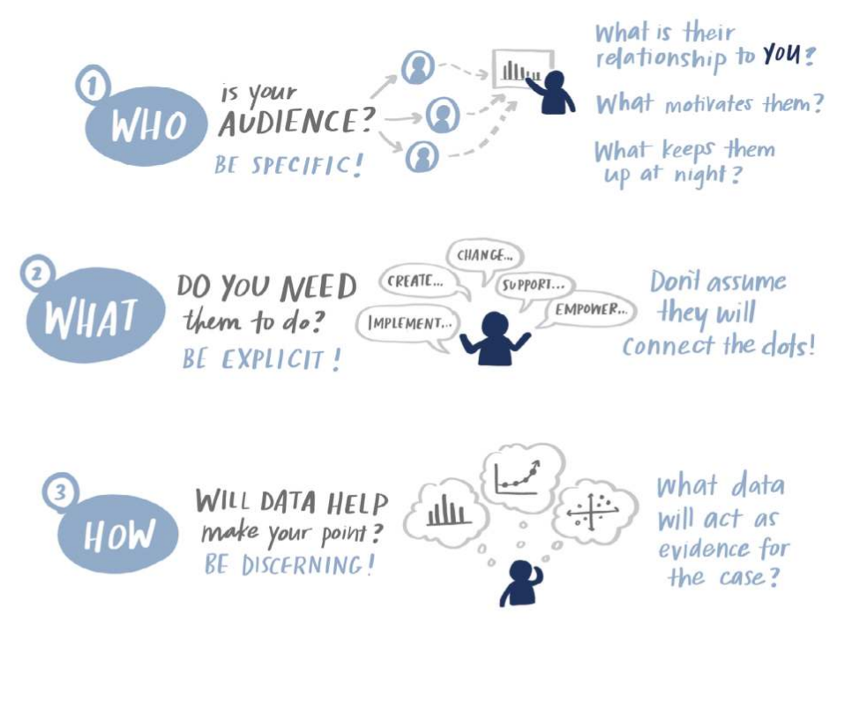
where to begin?
who, what and how
examples
1.
the budget committee that can approve funding for continuation of the summer learning program
2.
the summer learning program on science was a success; please approve budget of PX,XXX to continue
3.
illustrate success with data collected through the survey conducted before and after the pilot program.

Slide 14
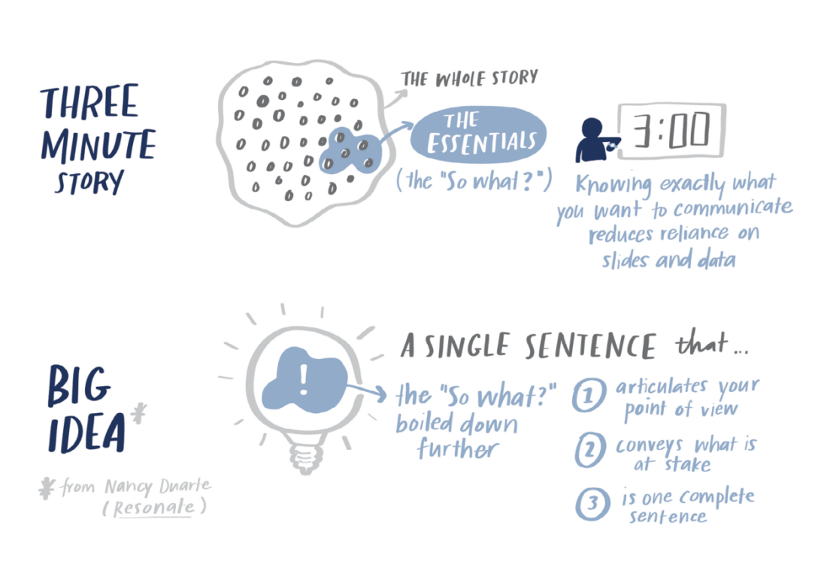
3-minute story and big idea
boil the “so-what” down to a paragraph and to a single concise statement
Notes:
Make it short and simple, don’t beat around the bush

Slide 15
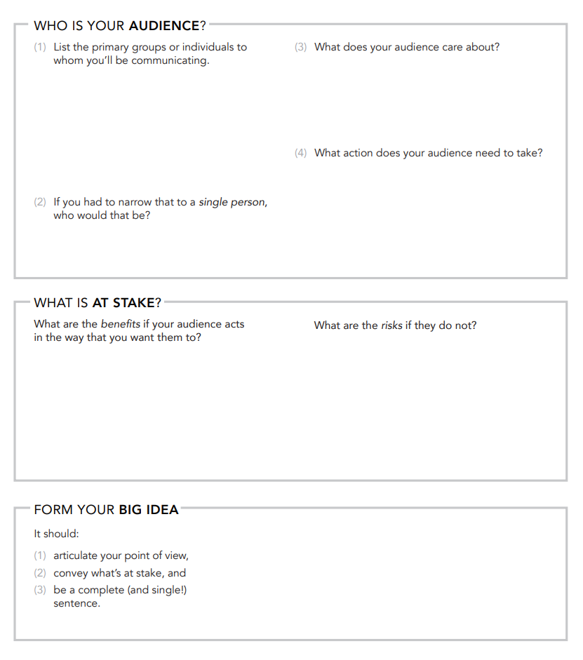
The BIG IDEA worksheet

Slide 16
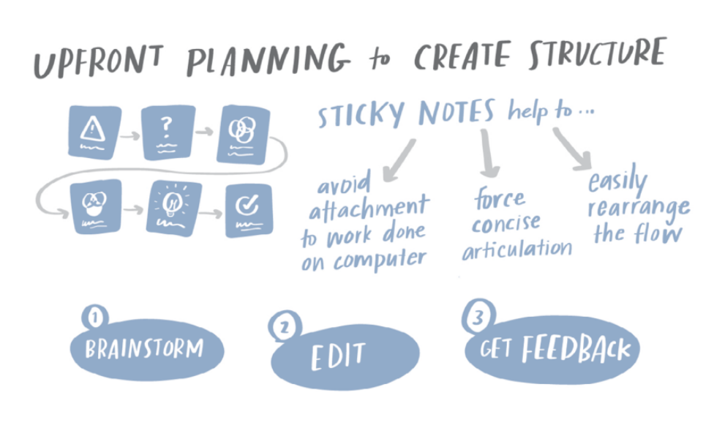
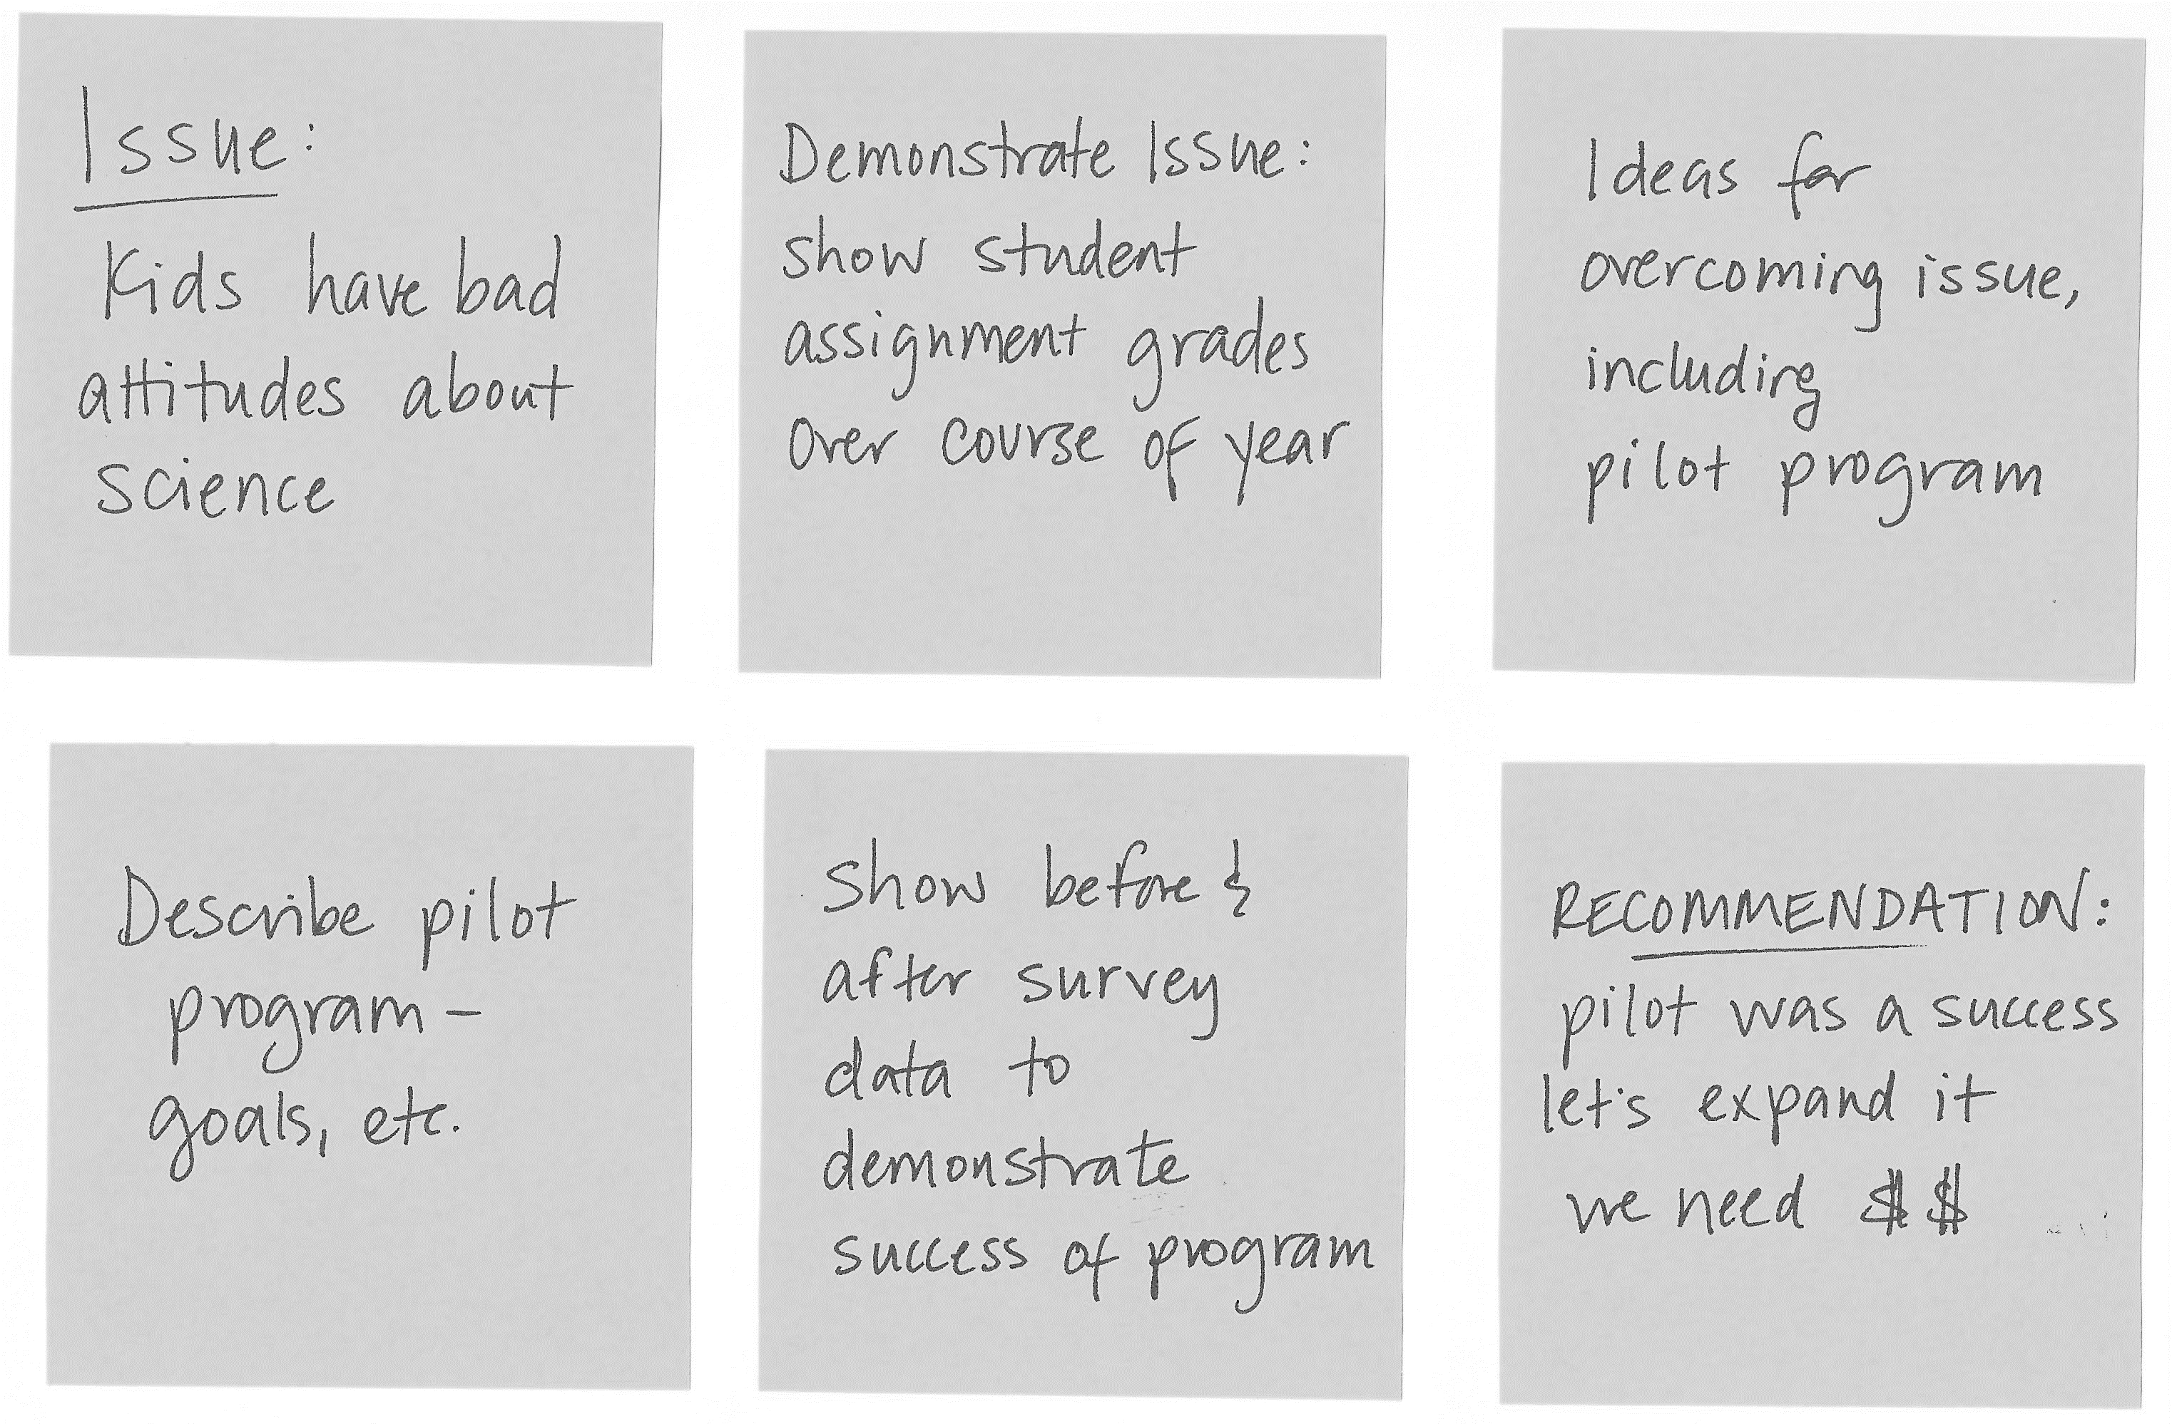
storyboarding
establish a structure for your communication
example

Slide 17
in closing
have a solid understanding of what you want to do before you start
get to know your audience
create the 3-minute story
complete the BIG IDEA worksheet
storyboard!

Slide 18
choosing
an
effective
visual
Lesson 2

Slide 19
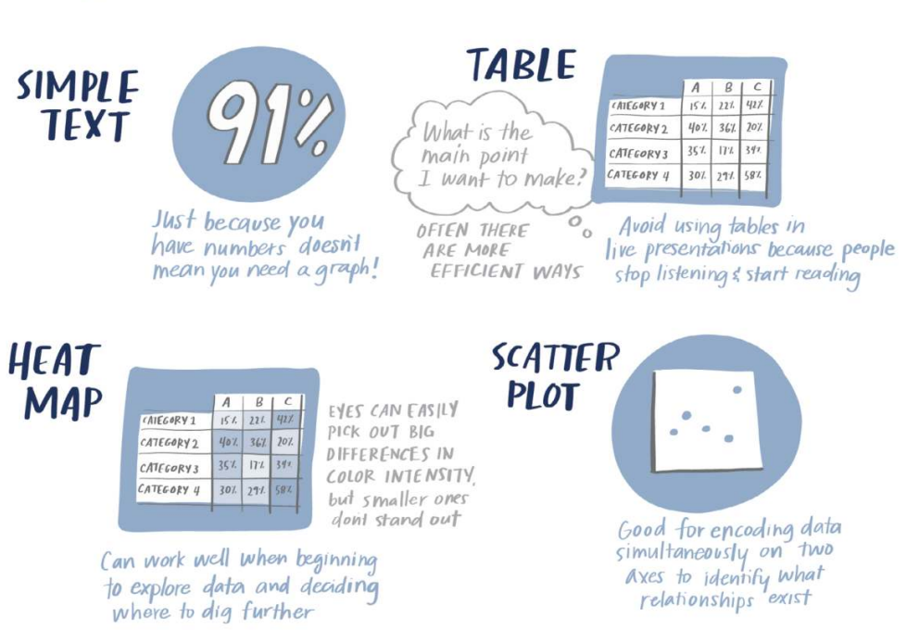
most common visuals
there is no single “right” answer when it comes to how to visualize data

Slide 20
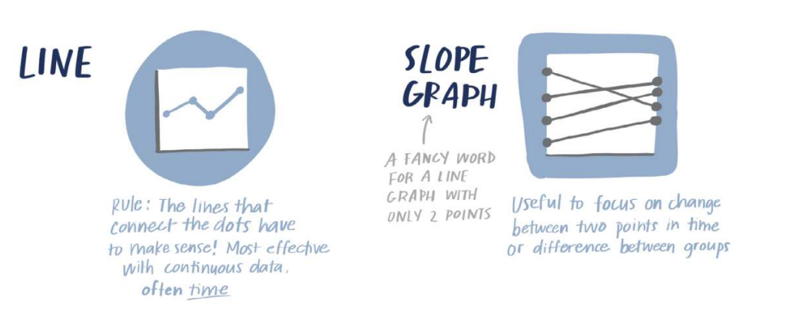
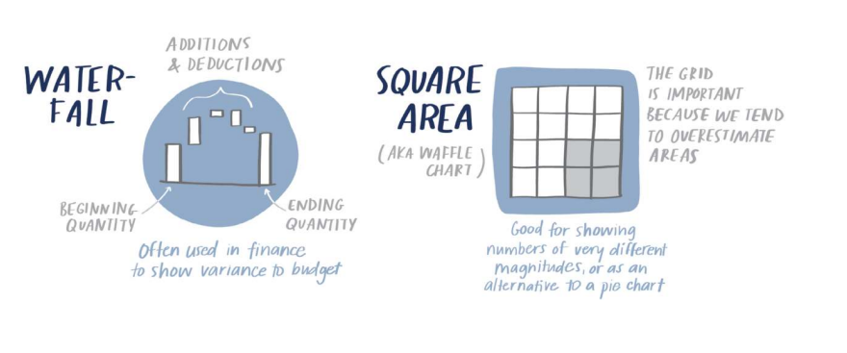
most common visuals
there is no single “right” answer when it comes to how to visualize data

Slide 21
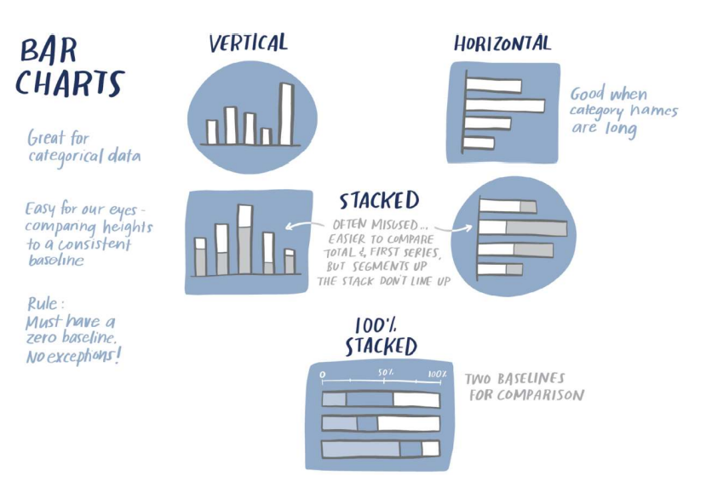
most common visuals
there is no single “right” answer when it comes to how to visualize data

Slide 22
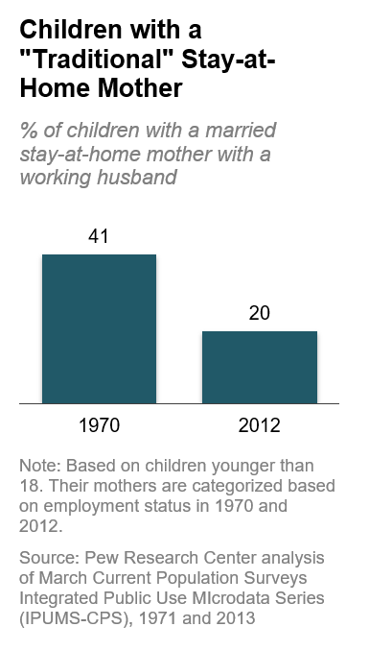
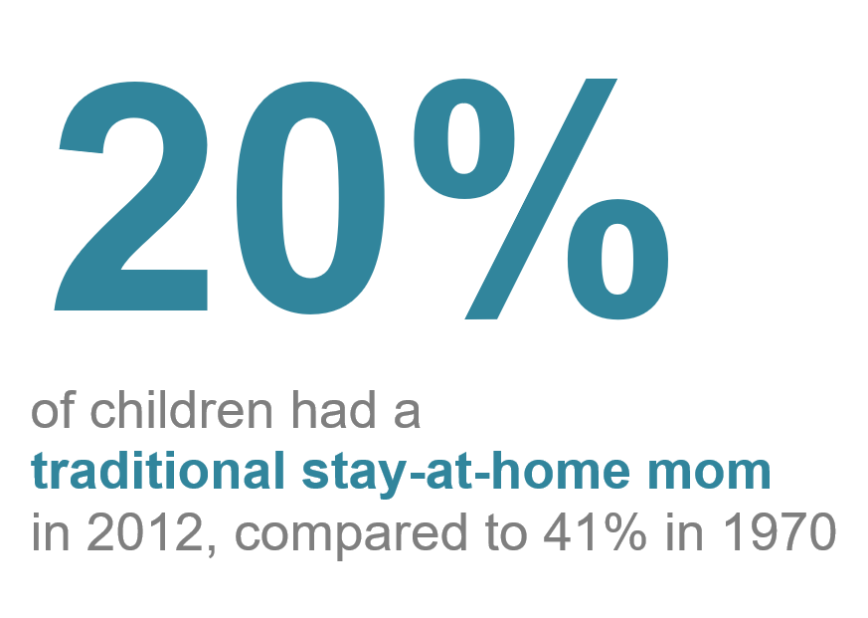
simple text
when you have just a number or two to share, use simple text to communicate

Slide 23
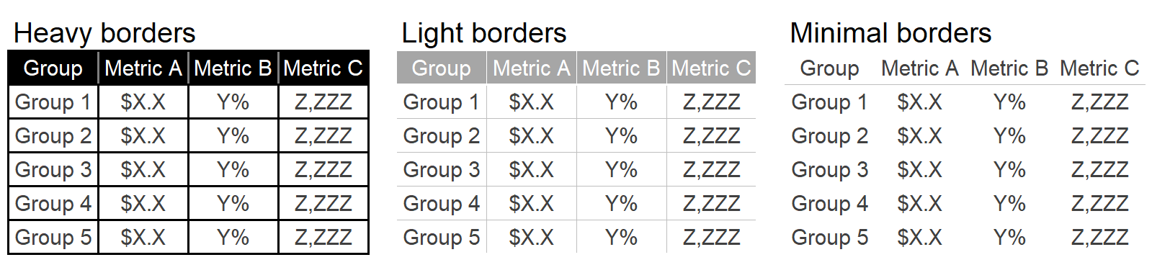
tables
data should stand out, not the borders
NOTE: Using a table in alive presentation is rarely a good idea. As your audience reads it, you lose their ears and attention to make your point verbally. There will be a better way to pull out and visualize the piece or pieces of interest. Consider including a full table in the appendix and a link or reference to it which might meet your audience’s needs.

Slide 24
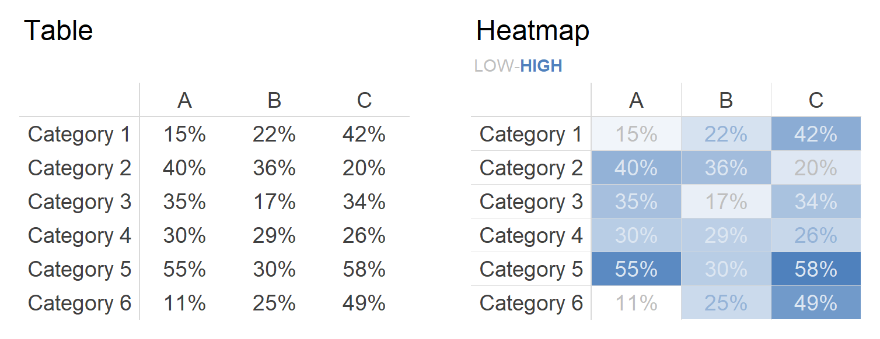
heatmap
a table that leverages colored cells to convey relative magnitude of the numbers

Slide 25
charts or graphs?
what’s the diff?
Some draw a distinction between charts and graphs. Typically, “chart” is the broader category, with “graphs” being one of the subtypes (other chart types include maps and diagrams).

Slide 26
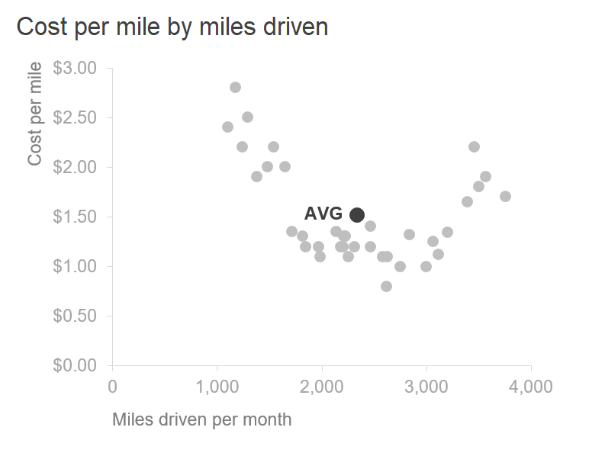
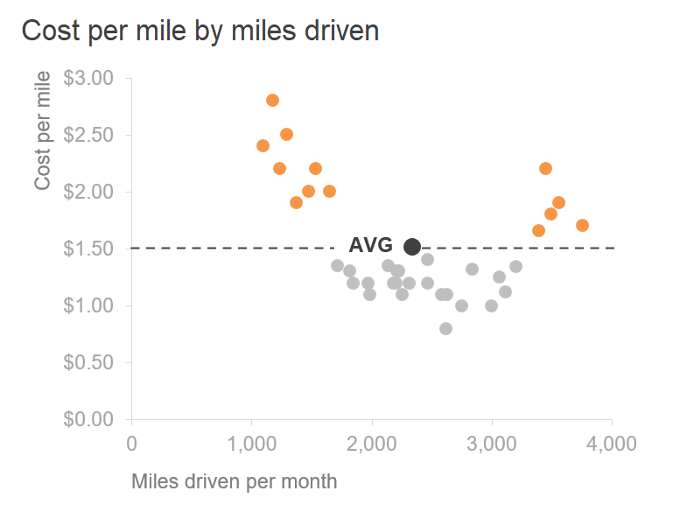
scatterplots
useful for showing the relationship between two things

Slide 27
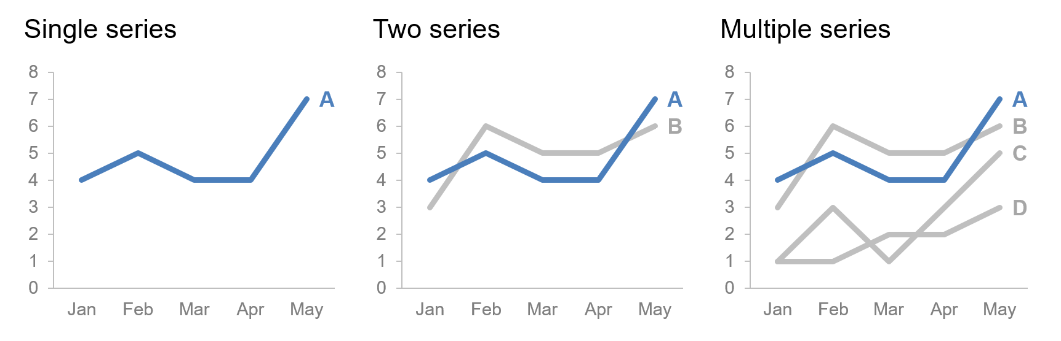
line graph
commonly used to plot continuous data (e.g., days, months, quarters, years)

Slide 28
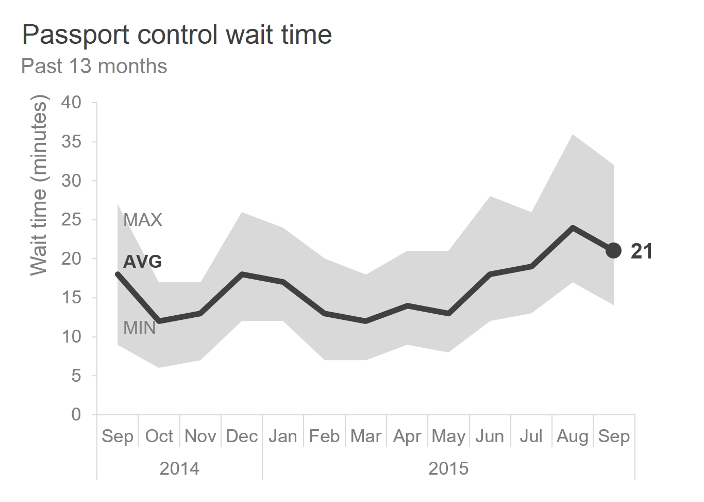
line graph
showing average within a range

Slide 29
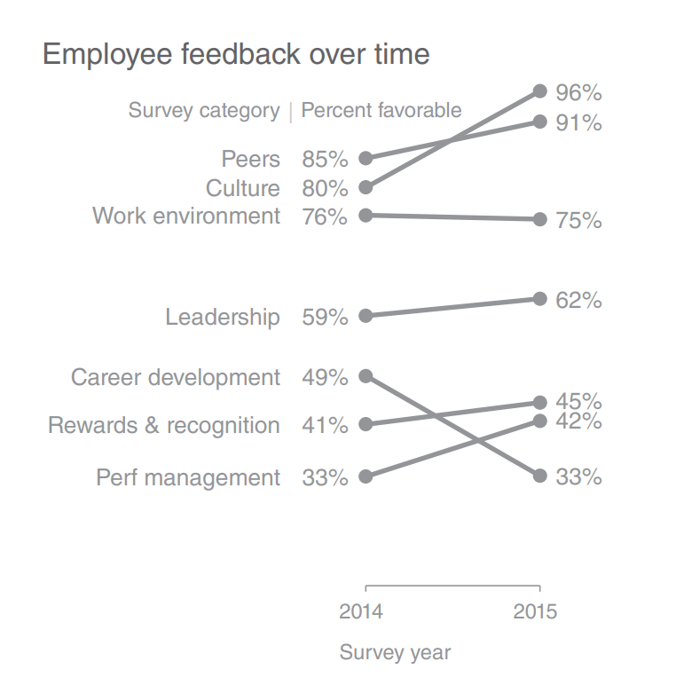
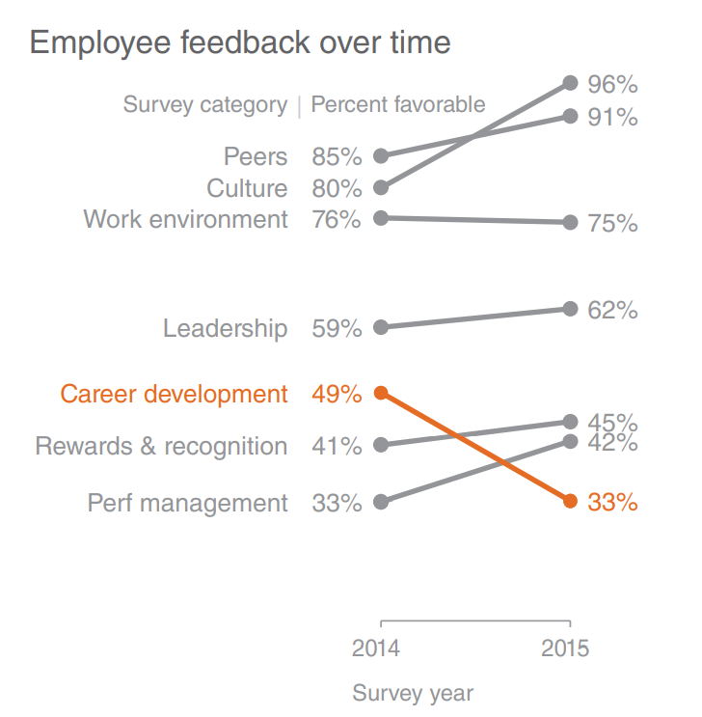
slopegraph
shows relative increases and decreases across categories between two points

Slide 30
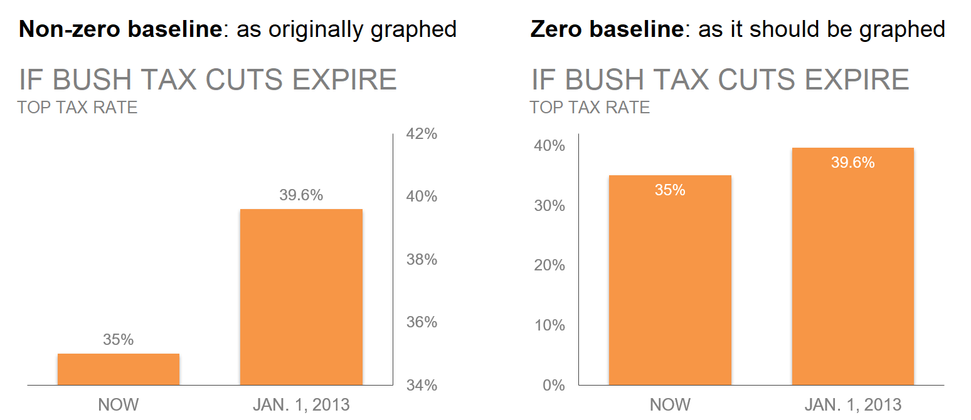
bars
should be leveraged because they are common, do not avoid
NOTE: bar graphs must have a zero baseline

Slide 31
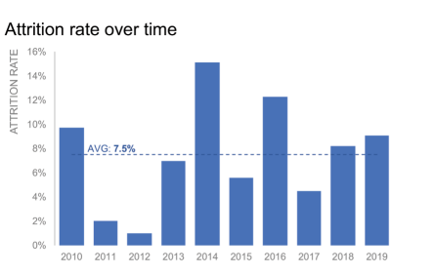
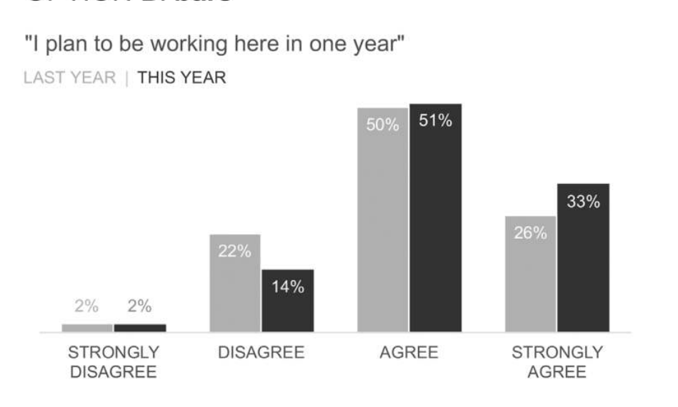
bars
for bigger picture trends, preserve and deemphasize axis,
otherwise omit the axis and label data points directly

Slide 32
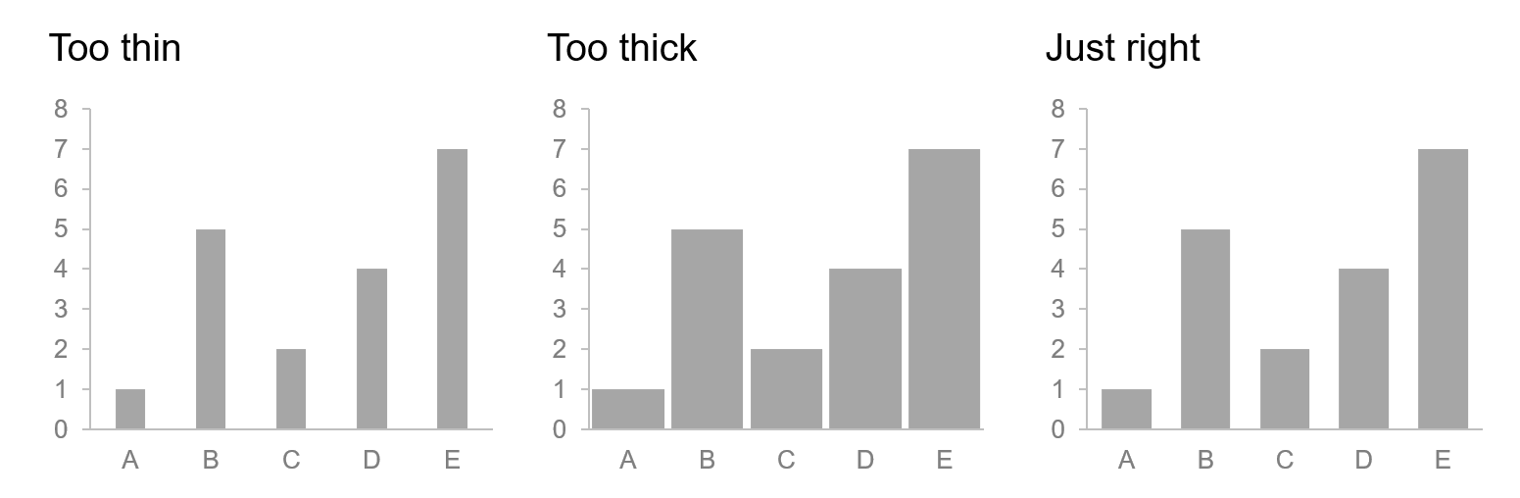
bars
in general, bars should be wider than the white space between them

Slide 33
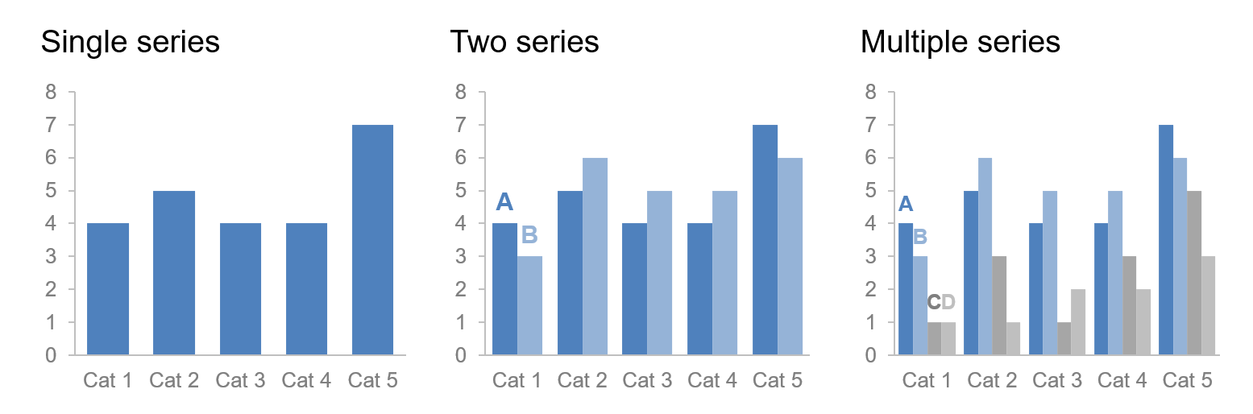
bars: vertical bar chart
as you add more series of data, it becomes more difficult to focus and pull insight
NOTE: use multiple series bar charts with caution

Slide 34
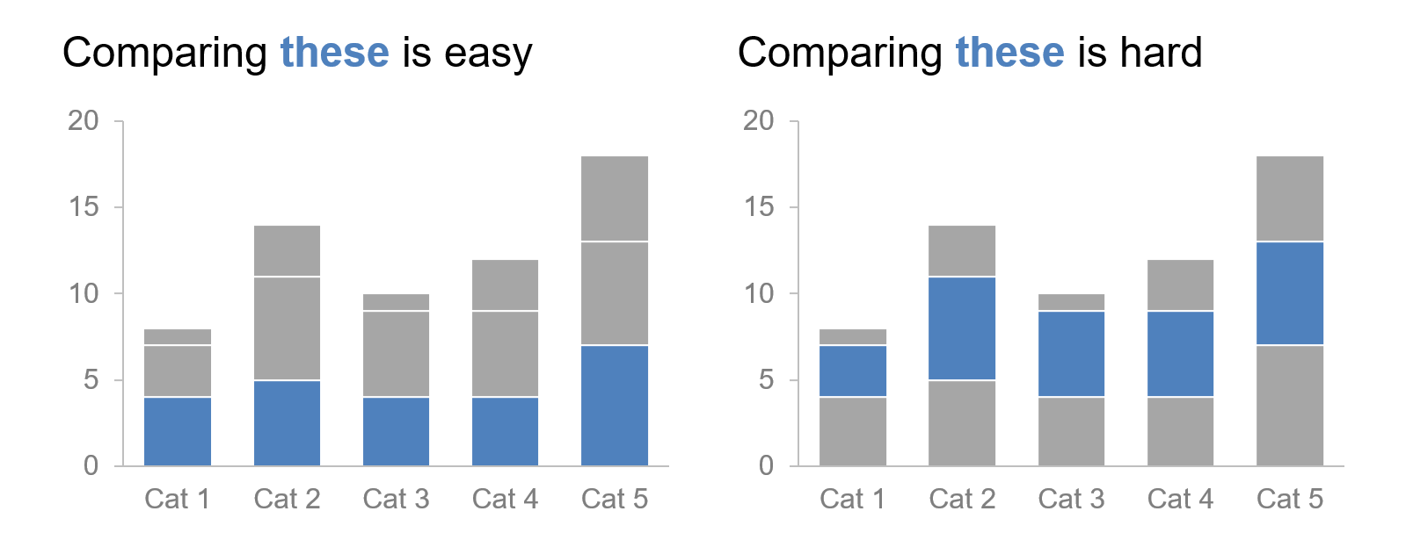
bars: stacked vertical bar chart
compare totals across categories and see the subcomponent pieces within a given category

Slide 35
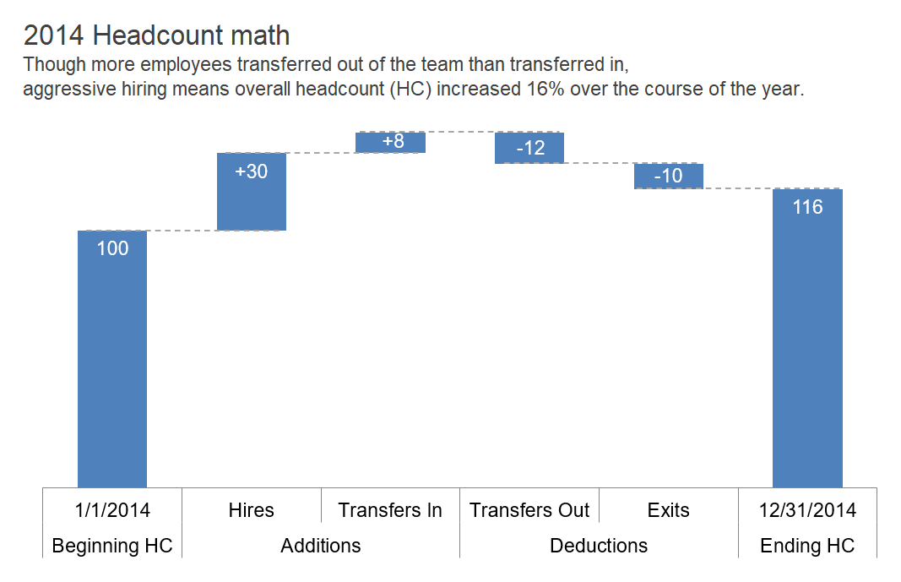
bars: waterfall chart
pull apart the pieces of a stacked bar chart to focus on one at a time, or to show a starting point, increases and decreases, and the resulting ending point

Slide 36
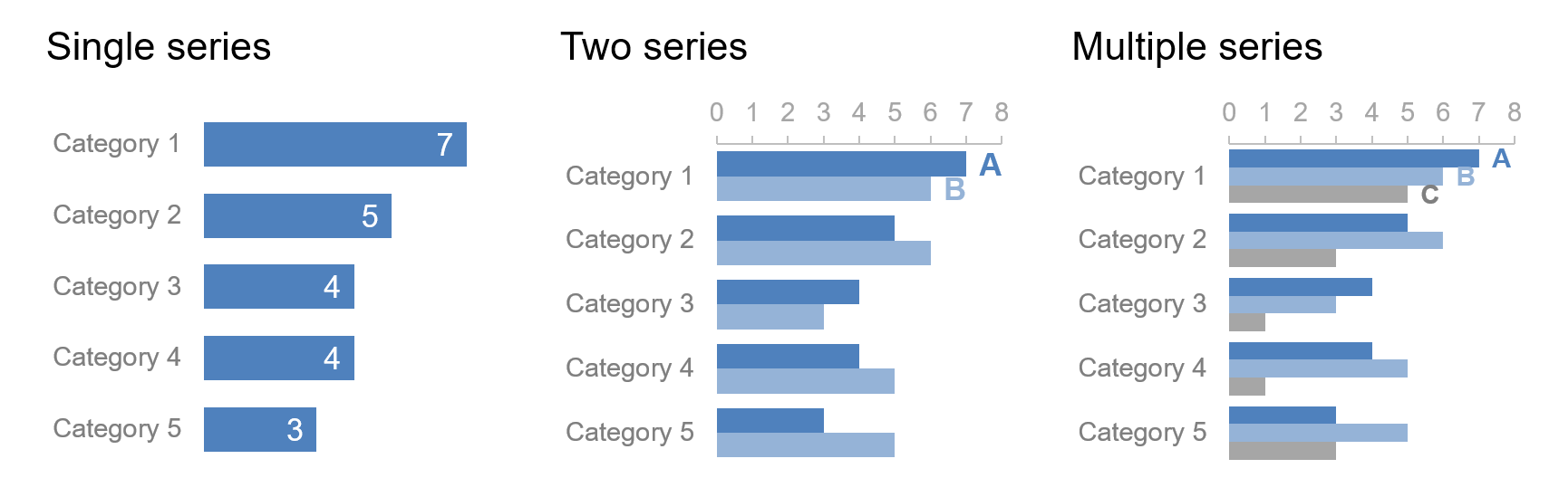
bars: horizontal bar chart
the single go-to graph for categorical data, it’s very easy to read
NOTE: If the biggest category is the most important, think about putting that first and ordering the rest of the categories in decreasing numerical order. Or if the smallest is most important, put that at the top and order by ascending data values. If there is a natural order (e.g., age groups), you may keep it.

Slide 37
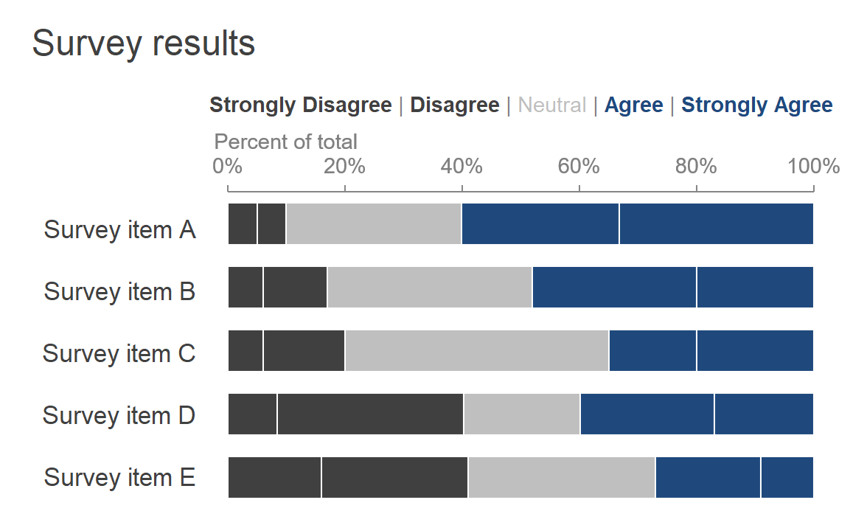
bars: stacked horizontal bar chart
show the totals across different categories but also give a sense of the subcomponent pieces; can show absolute values or sum to 100%

Slide 38
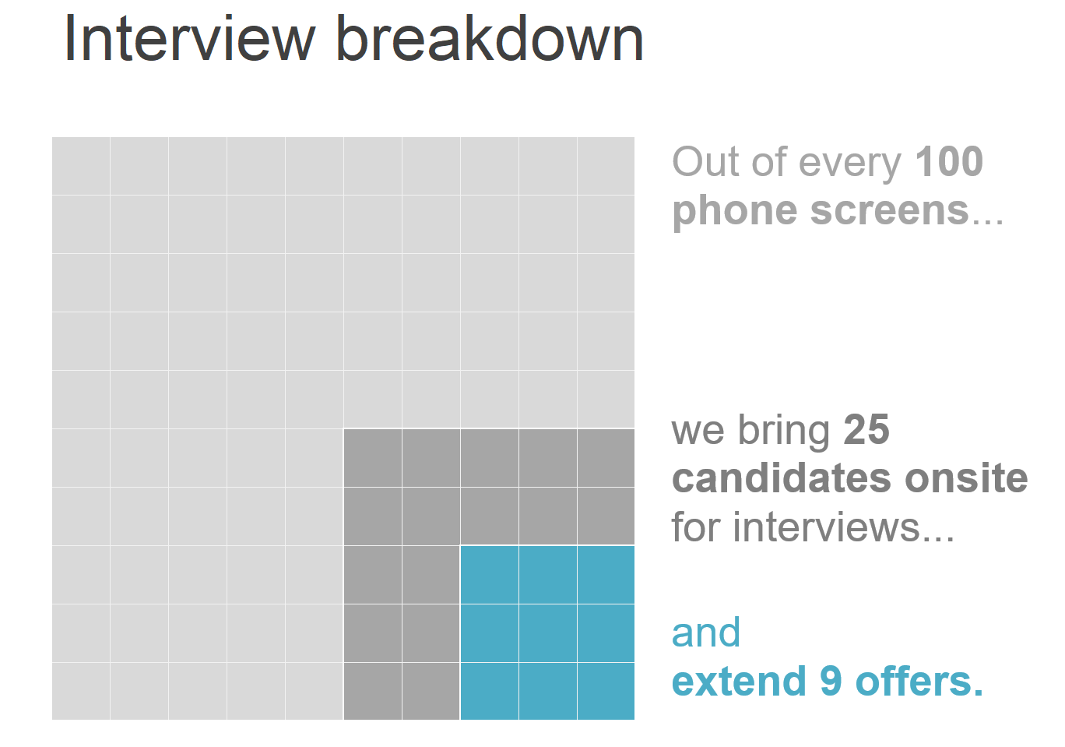
area
typically avoid them, with one exception—when we need to visualize numbers of vastly different magnitudes
NOTE: Humans’ eyes don’t do a great job of attributing quantitative value to two‐dimensional space, which can render area graphs harder to read than some of the other types of visual displays we’ve discussed.

Slide 39
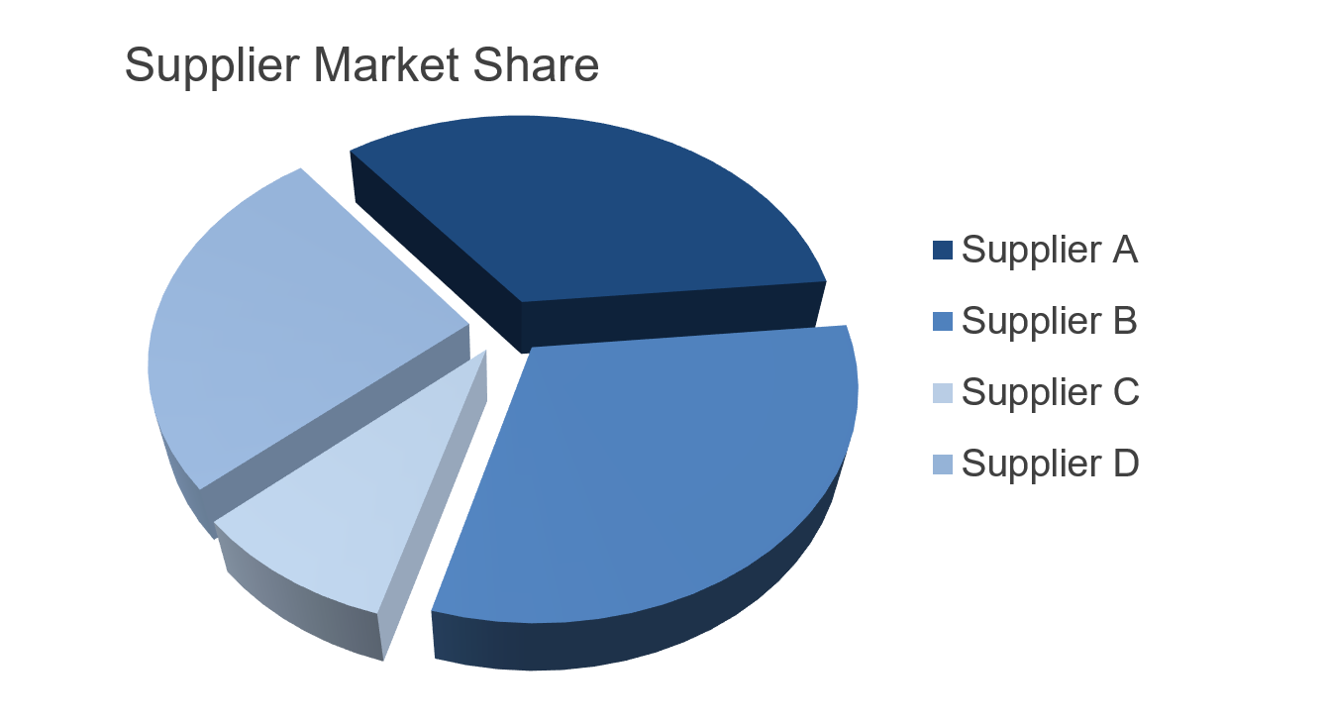
pie charts
they are evil

Slide 40
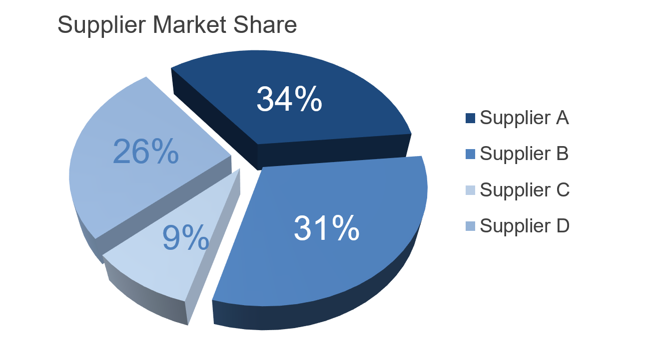
pie charts
they are evil

Slide 41
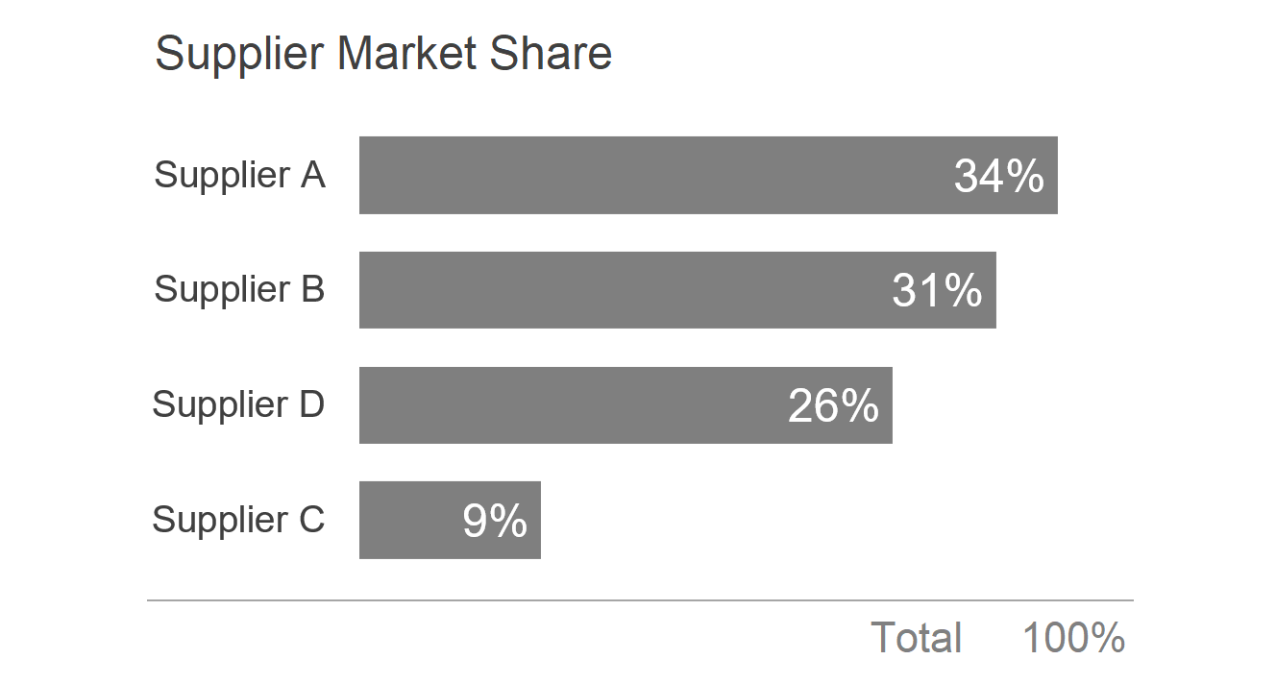
pie charts
which is better? if your visual is difficult to read, is it worth it?

Slide 42
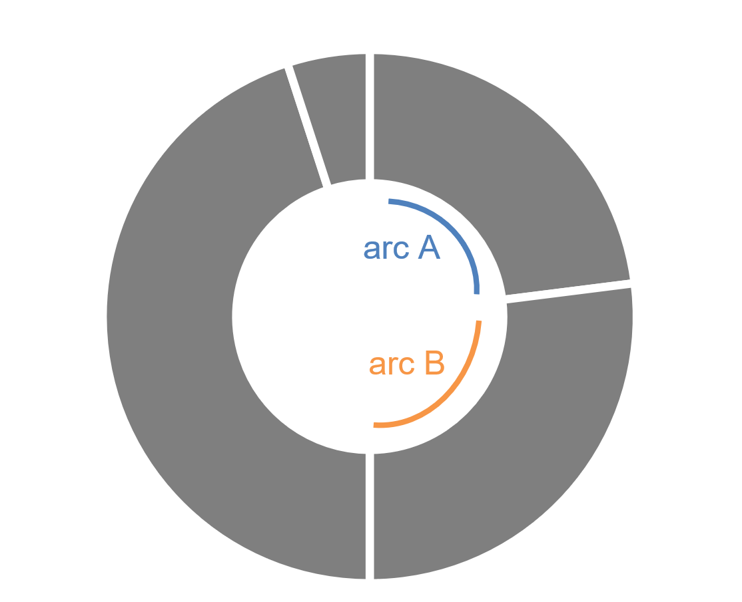
donut charts
another “dessert visual” to avoid

Slide 43
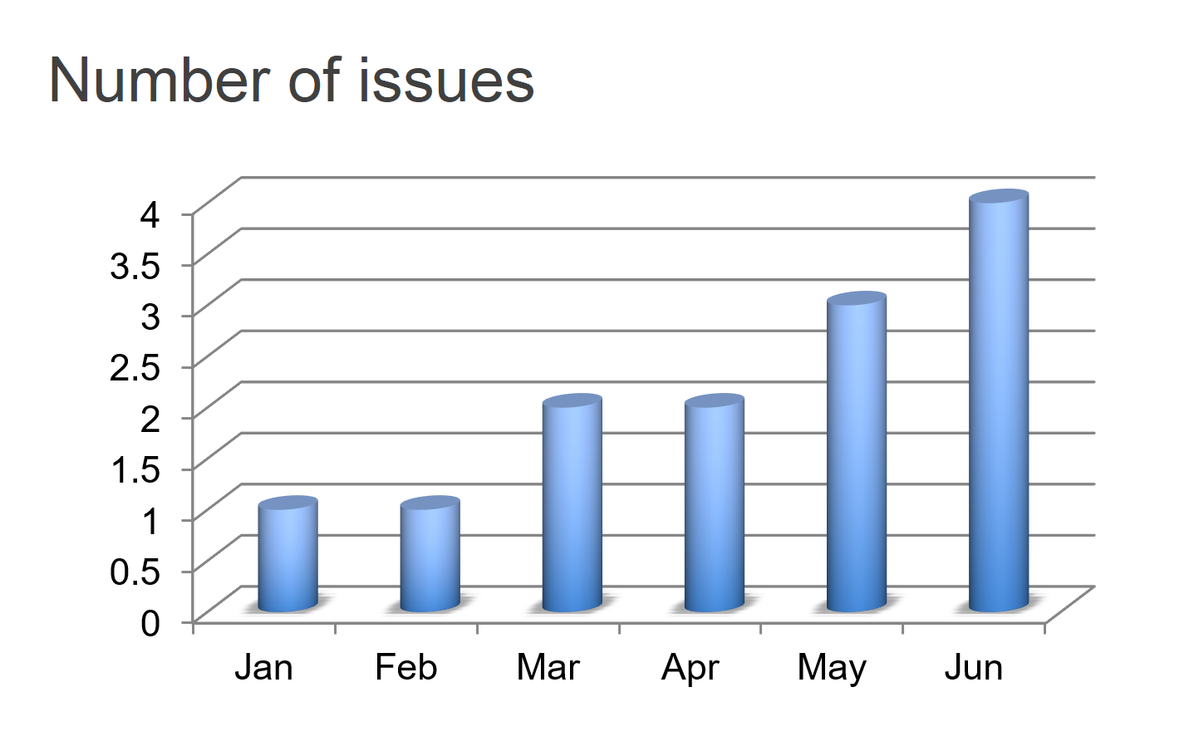
other tips: never use 3D
repeat after me: never use 3D
skews our numbers
Introduces unnecessary charts elements like side and floor panels
difficult to interpret

Slide 44
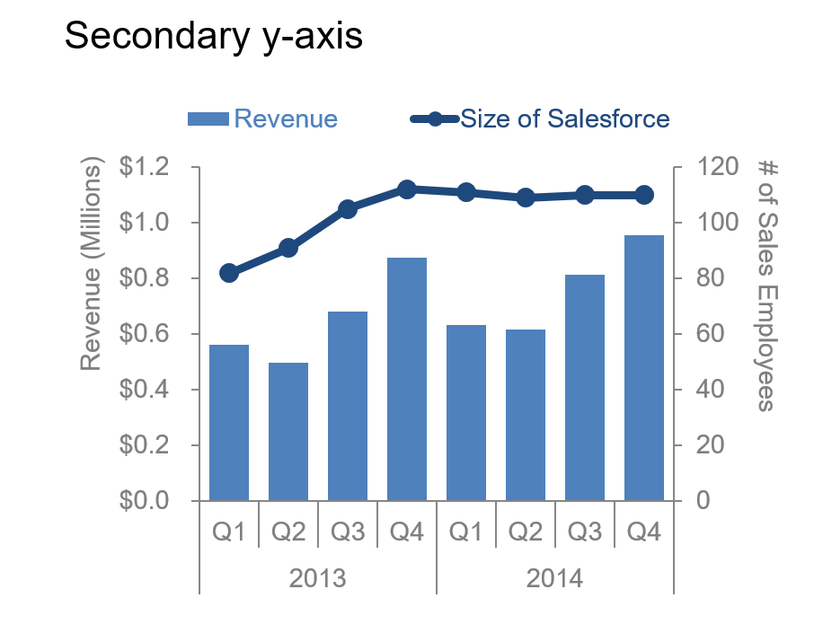
other tips: secondary y-axis is not a good idea
takes some time to understand which data should be read against which axis

Slide 45
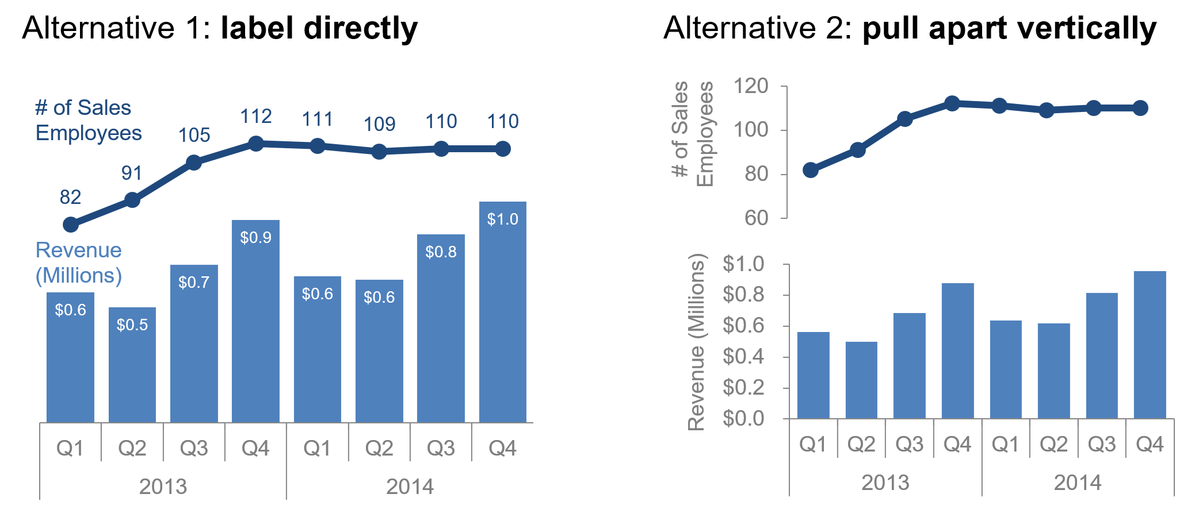
other tips: secondary y-axis is not a good idea
strategies for avoiding a secondary y-axis

Slide 46
in closing
good data visualization—infographic or otherwise—is not simply a collection of facts on a given topic; good data visualization tells a story
there isn’t a single correct visual display; rather, often there are different types of visuals that could meet a given need
choose a visual display that will help you convey what your audience need to know; whatever will be easiest for them to read is the right graph
to assess whether your visual is hitting the mark, have your audience articulate the following as they process the information:
where they focus
what they see
what observations they make
what questions they have

Slide 47
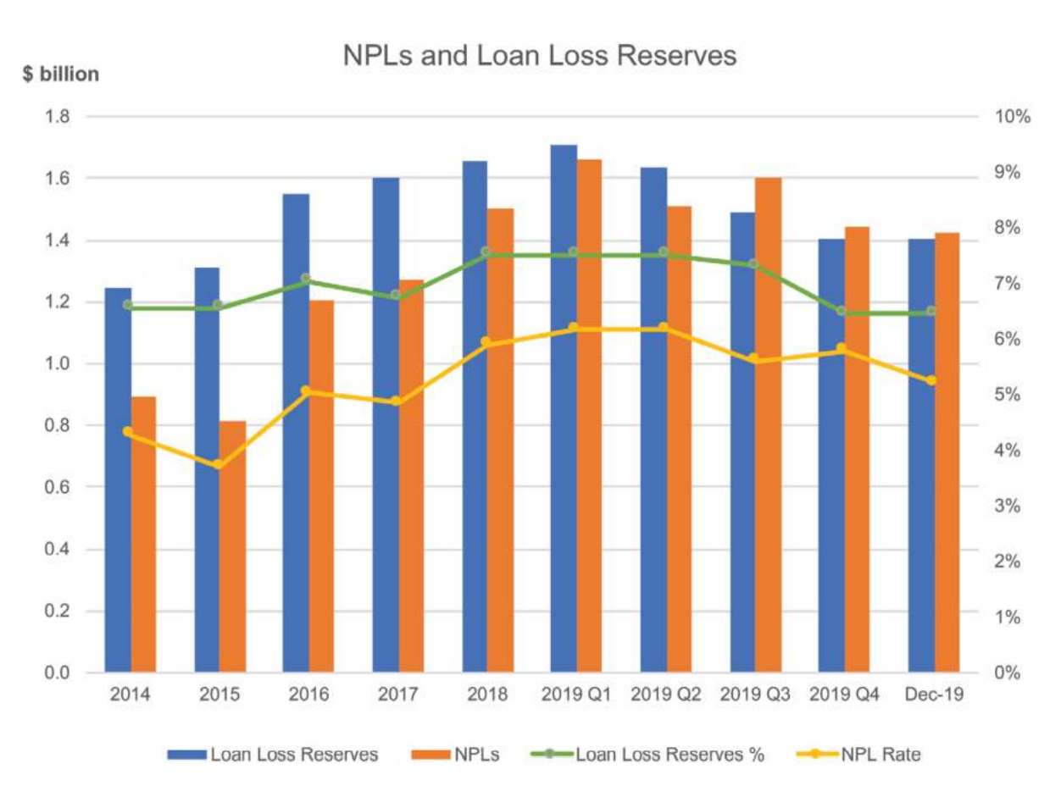
what’s wrong with this graph?

Slide 48
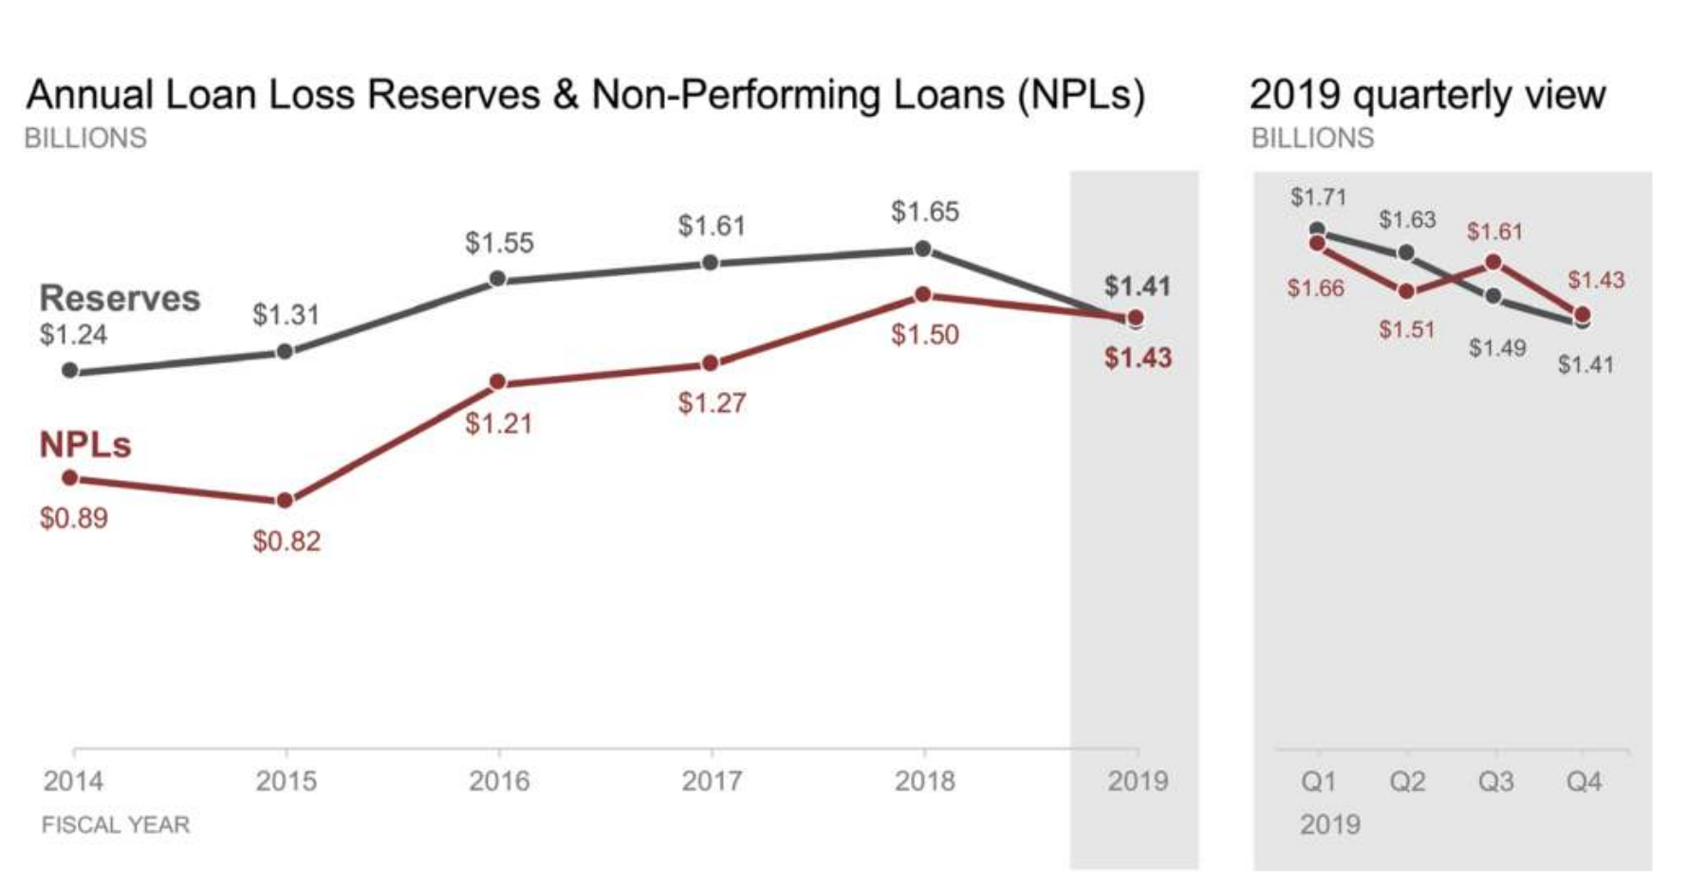
There, we fixed it

Slide 49
clutter
your
is
!
enemy
Lesson 3

Slide 50
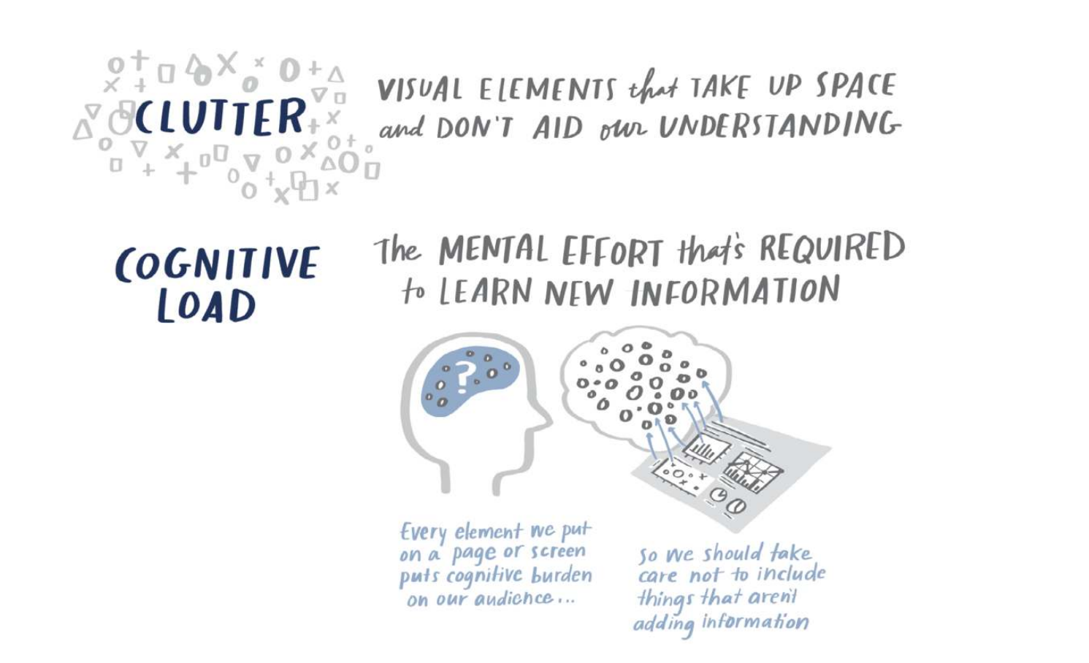
clutter is your enemy
ban clutter from your visuals!

Slide 51
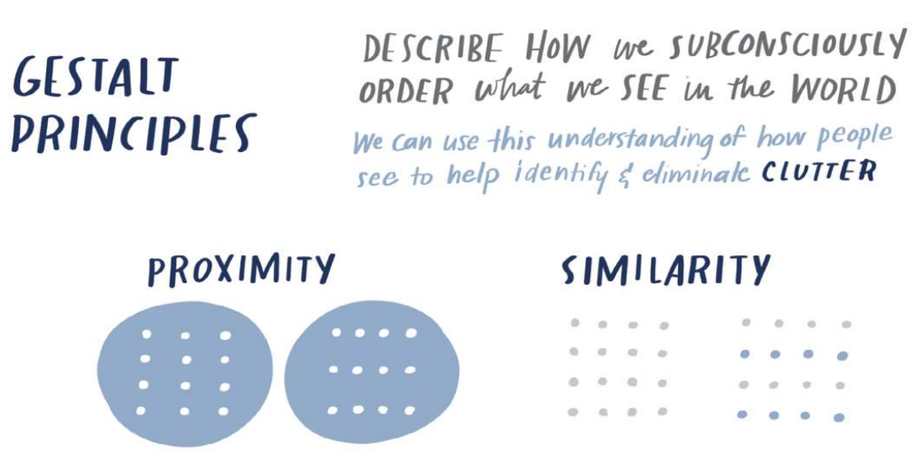
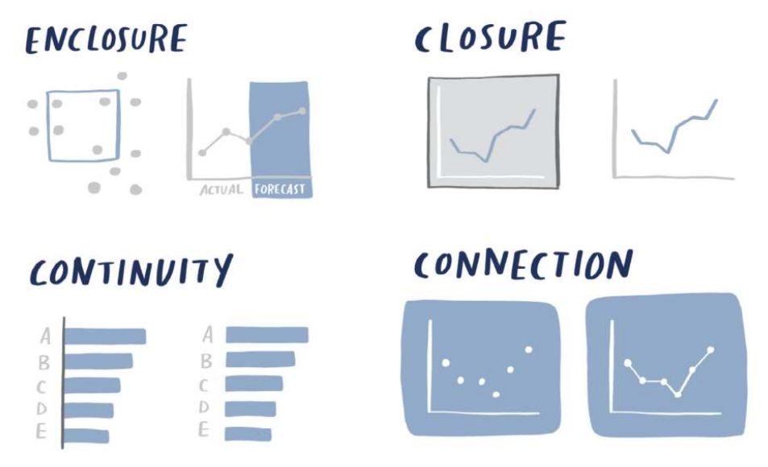
gestalt principles of visual perception
use this as guide to identify and eliminate clutter

Slide 52


proximity
we tend to think of objects that are physically close together as belonging to part of a group

Slide 53
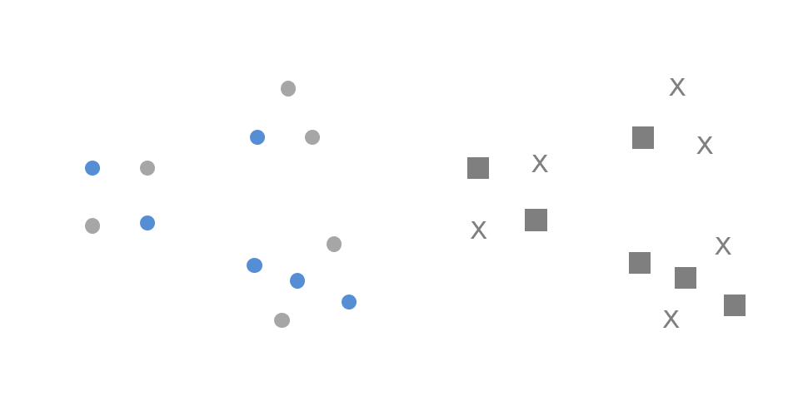
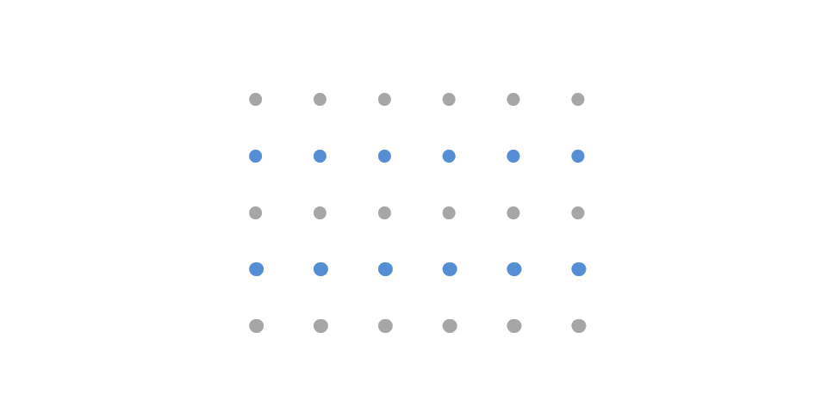
similarity
objects that are of similar color, shape, size, or orientation are perceived as related or belonging to part of a group

Slide 54
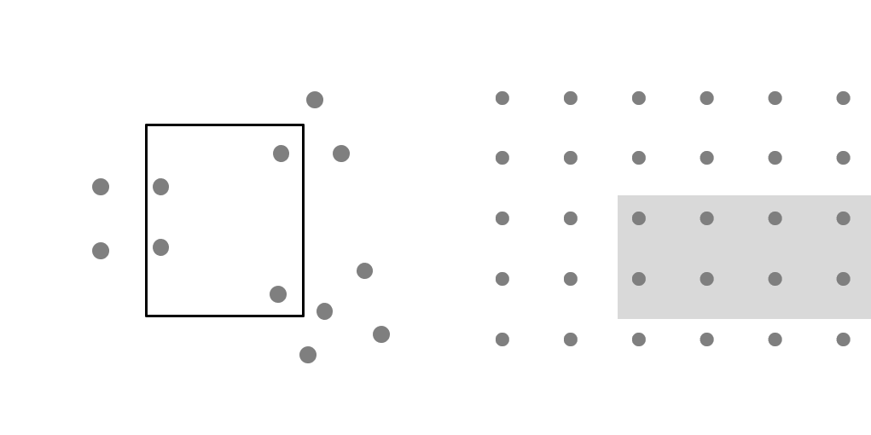

enclosure
we think of objects that are physically enclosed together as belonging to part of a group

Slide 55


closure
when parts of a whole are missing, our eyes fill the gap
Notes:
Bonus: when we take away those unnecessary elements, our data stands out more, as shown in the last chart at the right compared to the middle chart.

Slide 56


continuity
our eyes seek the smoothest path and naturally create continuity in what we see even where it may not explicitly exist
Notes:
The principle of continuity is similar to closure: when looking at objects, our eyes seek the smoothest path and naturally create continuity in what we see even where it may not explicitly exist

Slide 57


connection
connective property typically has a stronger associative value than similar color, size, or shape

Slide 58

lack of visual order
before

Slide 59

with visual order
after

Slide 60
alignment
diagonal elements such as lines and text should be avoided
205% slower to read
no rotation
45 degrees
90 degrees
52% slower to read
- Wigdor & Balakrishnan, 2005

Slide 61

alignment
turn on the rulers or gridlines of your PowerPoint

Slide 62
white space
we need to get more comfortable with white space
minimal guidelines:
margins should remain free of text and visuals
resist the urge to stretch visuals to take up the available space; instead, appropriately size your visuals to their content
think about how you can use white space strategically for emphasis

Slide 63

non-strategic use of contrast
before

Slide 64

non-strategic use of contrast
after

Slide 65
decluttering:
step-by-step

Slide 66

original graph
let’s break this down
Scenario: Your team receives tickets from employees through samanage. In the past year, you’ve had a couple of people leave and decided at the time not to replace them. You’ve heard a rumbling of complaints from the remaining employees about having to “pick up the slack”. You’ve just been asked about your hiring needs for the coming year and are wondering if you should hire a couple more people.

Slide 67
original graph
let’s break this down
First, you want to understand what impact the departure of individuals over the past year has had on your team’s overall productivity. You plot the monthly trend of incoming tickets and those processed
over the past year. You see that there is some evidence your team’s productivity is suffering from being short‐staffed and now want to turn the quick‐and‐dirty visual you created into the basis for your hiring request.

Slide 68
step 1: remove chart border
chart borders are usually unnecessary
think about using white space to differentiate the visual from other elements on the page as needed

Slide 69

step 2: remove gridlines
if you think it will be helpful for your audience to trace their finger from the data to the axis, you can leave the gridlines
if you use gridlines, make them thin and use a light color like grey.
do not let gridlines compete visually with your data
when you can, get rid of gridlines altogether

Slide 70

step 3: remove data markers
data markers add cognitive load to process data that is already depicted visually with the lines.
use data markers on purpose and with a purpose

Slide 71

step 4: clean up axis labels
eliminate trailing zeros on y-axis: they carry no informative value and make numbers more complicated
eliminate the diagonal text: abbreviate the months

Slide 72

step 5: label data directly
identify anything that will feel like effort to our audience and take that work upon ourselves as the designers of the information
leverage Gestalt principle of proximity and put the data labels right next to the data they describe

Slide 73

step 6: leverage consistent color
leverage Gestalt principle of similarity and make the data labels the same color as the data they describe
visual cue: “these two pieces of information are related”

Slide 74

before and after

Slide 75
Clutter is your enemy: ban it from your visuals!

Slide 76
focus
audience’s
your
attention
Lesson 4

Slide 77

brain and memory

Slide 78

Count the 3s

Slide 79

Count the 3s again: with preattentive attributes

Slide 80
If we use preattentive attributes strategically, they can help us
enable our audience to see what we want them to see before they even know they’re seeing it!

Slide 81

preattentive attributes
signal where to look and create a visual hierarchy of information to help ease the processing of information

Slide 82
preattentive attributes in text
original text, no preattentive attributes
What are we doing well? Great Products. These products are clearly the best in their class. Replacement parts are shipped when needed. You sent me gaskets without me having to ask. Problems are resolved promptly. Bev in the billing office was quick to resolve a billing issue I had. General customer service exceeds expectations. The account manager even called to check in after normal business hours.
You have a great company – keep up the good work!

Slide 83
preattentive attributes in text
color
What are we doing well? Great Products. These products are clearly the best in their class. Replacement parts are shipped when needed. You sent me gaskets without me having to ask. Problems are resolved promptly. Bev in the billing office was quick to resolve a billing issue I had. General customer service exceeds expectations. The account manager even called to check in after normal business hours.
You have a great company – keep up the good work!

Slide 84
preattentive attributes in text
italics
What are we doing well? Great Products. These products are clearly the best in their class. Replacement parts are shipped when needed. You sent me gaskets without me having to ask. Problems are resolved promptly. Bev in the billing office was quick to resolve a billing issue I had. General customer service exceeds expectations. The account manager even called to check in after normal business hours.
You have a great company – keep up the good work!

Slide 85
preattentive attributes in text
size
What are we doing well? Great Products. These products are clearly the best in their class. Replacement parts are shipped when needed. You sent me gaskets without me having to ask. Problems are resolved promptly. Bev in the billing office was quick to resolve a billing issue I had. General customer service exceeds expectations. The account manager even called to check in after normal business hours. You have a great company – keep up the good work!

Slide 86
preattentive attributes in text
separate spatially
What are we doing well? Great Products. These products are clearly the best in their class. Replacement parts are shipped when needed. You sent me gaskets without me having to ask.
Problems are resolved promptly.
Bev in the billing office was quick to resolve a billing issue I had. General customer service exceeds expectations. The account manager even called to check in after normal business hours.
You have a great company – keep up the good work!

Slide 87
preattentive attributes in text
outline (enclosure)
What are we doing well? Great Products. These products are clearly the best in their class. Replacement parts are shipped when needed. You sent me gaskets without me having to ask. Problems are resolved promptly. Bev in the billing office was quick to resolve a billing issue I had. General customer service exceeds expectations. The
account manager even called to check in after normal business hours.
You have a great company – keep up the good work!

Slide 88
preattentive attributes in text
underline (added marks)
What are we doing well? Great Products. These products are clearly the best in their class. Replacement parts are shipped when needed. You sent me gaskets without me having to ask. Problems are resolved promptly. Bev in the billing office was quick to resolve a billing issue I had. General customer service exceeds expectations. The account manager even called to check in after normal business hours.
You have a great company – keep up the good work!

Slide 89
preattentive attributes in text
this is how it’s done using the previous example
What are we doing well?
Themes & example comments
Great products: “These products are clearly the best in their class.”
Replacement parts are shipped when needed: “You sent me gaskets without me having to ask, and I really needed them, too!”
Problems are resolved promptly: “Bev in the billing office was quick to resolve a billing issue I had.”
General customer service exceeds expectations: “The account manager even called to check in after normal business hours. You have a great company – keep up the good work!

Slide 90
Studies have shown that we have about 3-8 seconds with our audience, during which time they decide whether to continue to look at what we’ve put in front of them or direct their attention to something else.

Slide 91

preattentive attributes in graphs
no preattentive attributes
you want to share an insight about the top design concerns (measured as the number of concerns per 1,000 concerns) from customers for a particular vehicle make and model

Slide 92

preattentive attributes in graphs
leverage color to draw attention

Slide 93

preattentive attributes in graphs
create a visual hierarchy of information

Slide 94
preattentive attributes in graphs
highlighting one aspect can make other things harder to see
O
ne word of warning in using preattentive attributes: when you highlight one point in your story, it can actually make other points harder to see. When
you’re doing exploratory analysis, you should mostly avoid the use of preattentive attributes for this reason. When it comes to explanatory analysis, however, you should have a specific story you are communicating to your audience. Leverage preattentive attributes to help make that story visually clear.

Slide 95
preattentive attributes:
step-by-step

Slide 96
let’s further improve this graph

Slide 97

step 1: push everything to the background

Slide 98

step 2: make the data stand out

Slide 99

step 3: add data markers and numeric labels

Slide 100

step 4: preserve and eliminate

Slide 101

use color sparingly
too much variety prevents anything from standing out

Slide 102
use color consistently
a change in color signals just that—a change
Question: Does it make sense to change up the colors or graph types so the
audience doesn’t get bored?
Answer: No!
If you are designing your communication in shades of grey and using a single color to draw attention, leverage that same schematic throughout the communication.

Slide 103
design with colorblind in mind
8% of men and 0.5% of women are colorblind
avoid shades of red and green: you can use them but make sure to have some additional visual cue to set the important numbers apart (e.g., bold, varying saturation or brightness, or a simple plus or minus sign on numbers)
use blue to signal positive and orange for negative: positive and negative associations with these colors are still recognizable and we avoid the colorblind challenge

Slide 104
be thoughtful of tone color conveys
color evokes emotion
Consider the tone you want to set with your data visualization or broader communication and choose a color (or colors) that help reinforce the emotion you want to arouse from your audience.
Is the topic serious or lighthearted?
Are you making a striking bold statement and want your colors to echo it, or is a
more circumspect approach with a muted color‐scheme appropriate?

Slide 105
brand colors: to leverage or not to leverage?
companies have their branding and associated color palette
Identify one or maybe two brand-appropriate colors to use as your “audience-look-here” cues and keep the rest of your color palette relatively muted with shades of grey or black:
steel blue?
saffron yellow?
ice blue?

Slide 106

brand colors: to leverage or not to leverage?
companies have their branding and associated color palette

Slide 107

position on page
without other visual cues, the zigzag “z” will take over
we read from top left to the bottom right
put important things at the top (e.g., main takeaway or call to action)
for data viz, think about which data you want your audience to see first
aim to work within the way your audience takes in information, not against it
if it feels uncomfortable to look at, there’s something wrong
TIP: Negative values on the left while positive values on the right

Slide 108

in closing: where are your eyes drawn?
focus your audience’s attention where you want them to pay it

Slide 109
think
like a
designer
Lesson 5

Slide 110

form follows function
we can recognize smart design

Slide 111


affordances
when sufficient affordances are present, good design fades into the background

Slide 112
affordances: highlight the important stuff
At most, 10% of the visual design should be highlighted
Bold, italics, and underlining: use for titles, labels, captions, and short word sequences to differentiate elements
CASE or typeface: uppercase text in short word sequences is easily scanned, works well with titles, labels, and keywords
Color: use sparingly and with other highlighting techniques
Inversing elements: use sparingly as it can add considerable noise to a design
Size: attracts attention and signals importance

Slide 113

affordances: highlight the important stuff
Pew Research Center original graph
this graph is meant to demonstrate that the 2011 to 2012 increase observed in total new marriages was driven primarily by an increase in those having a bachelor’s degree or more (there doesn’t actually appear to be an increase based on the “All” trend shown, but let’s ignore this)

Slide 114

affordances: highlight the important stuff
Pew Research Center revised graph
by making everything else grey, the highlighting provides a clear signal of where we should focus our attention

Slide 115
affordances: eliminate distractions
“You know you’ve achieved perfection, not when you have nothing more to add, but when you have nothing to take away” – Saint‐Exupery, 1943
Specific considerations to help you identify potential distractions:
Not all data are equally important. Use your space and audience’s attention wisely by getting rid of noncritical data or components.
When detail isn’t needed, summarize. You should be familiar with the detail, but that doesn’t mean your audience needs to be.
Ask yourself: would eliminating this change anything? No? Take it out.
Push necessary, but non-message-impacting items to the background. Use your knowledge on preattentive attributes (light grey works well)

Slide 116

affordances: eliminate distractions
eliminate distractions on Pew Research’s graph
what we did:
bar graph to line graph (trends over time)
removed “All” category (non-value adding)
eliminated decimal points (fractions of a person?)
subtitle: italics to regular font
reduced space between title and subtitle
highlighted “bachelor’s degree or more” category

Slide 117

accessibility
“If it’s hard to read, it’s hard to do.”

Slide 118
accessibility: text is your friend
to label, introduce, explain, reinforce, highlight, recommend, and tell a story
every chart and its axis need an explicit title
avoid using descriptive titles (e.g. “2022 Budget”) instead, use an action title, a recommendation or something you want your audience to know or do (e.g. “Estimated 2022 spending is above budget”)
annotate important or interesting points directly on a graph

Slide 119

accessibility: annotation
an example of annotation

Slide 120

accessibility in action
let’s revisit the ticket example

Slide 121

accessibility in action
add words that must be here: graph title, axis titles, and a footnote

Slide 122

accessibility in action
add a call to action and annotation

Slide 123

aesthetics
is it necessary to “make it pretty?” yes

Slide 124

acceptance

Slide 125


in closing: what’s wrong with the left graph?
Notes:
Too many colors, cannot highlight the important parts

Slide 126
lessons
in
storytelling
Lesson 6

Slide 127


Slide 128
the red riding hood
power of repetition. the process of hearing, reading, and saying things numerous times helps to cement them in our long-term memory
plot-twists-ending (beginning, middle, and end). works to embed things in our memory for us to recall and retell the story

Slide 129

the magic story: storytelling in plays
story is a time-tested structure; we’ve been telling stories throughout history
setup. introduces the main character, or protagonist, their relationships, and the world in which they live. after, the main character is confronted with a problem
conflict. makes up the bulk of the story and depicts the main character’s attempt to resolve the problem and goes through major changes in his life
resolution. resolves the story and its subplots, includes climax, where the tensions of the story reach the highest point of intensity

Slide 130
the magic story: storytelling and the cinema
persuading with facts (conventional rhetoric) is not good enough
“If you do succeed in persuading them,
you’ve only done so on an intellectual basis.
That’s not good enough,
because people are not inspired to act by reason alone” (Fryer, 2003).

Slide 131
the magic story: storytelling and the cinema
an example of persuading with facts: conventional rhetoric
Red Riding Hood (RRH) has to walk 1 km from Point A (home) to Point B (Grandma’s)
RRH meets Wolf, who (1) runs ahead to Grandma’s, (2) eats her, and (3) dresses in her clothes
RRH arrives at Grandma’s at 2pm, asks her three questions
Identified problem: after third question, Wolf eats RRH
Solution: vendor (Woodsman) employs tool (axe)
Expected outcome: Grandma and RRH alive, wolf is not

Slide 132
the magic story: storytelling and the cinema
what exactly is a story?
At fundamental level, a story expresses how and why life changes
Starts with balance
In the middle, something happens—an event that throws things out of balance
The resulting struggle, conflict, and suspense are critical components of the story
We can use stories to engage our audience emotionally in a way that goes beyond what facts can do.

Slide 133
the magic story: storytelling and the written word
don’t communicate for yourself—communicate for your audience
find a subject you care about.
do not ramble, though.
keep it simple.
have the guts to cut.
sound like yourself
say what you meant to say
pity the readers
Keep it simple. Edit ruthlessly. Be authentic.

Slide 134

constructing the story

Slide 135
constructing the story
the beginning: get everyone on common ground so the story can proceed
the setting: when and where does the story take place?
the main character: who is driving the action (this should be framed in terms of your audience!)
the imbalance: why is it necessary, what has changed?
the balance: what do you want to see happen?
the solution: how will you bring about the changes?

Slide 136
constructing the story
the middle: convince your audience of the need for action
further develop the situation or problem by covering relevant background
incorporate external context or comparison points
give examples that illustrate the issue
include the data that demonstrates the problem
articulate what will happen if no action is taken

Slide 137
constructing the story
the middle: convince your audience of the need for action
discuss potential options for addressing the problem
illustrate the benefits of your recommended solution
make it clear to your audience why they are in a unique position to make a decision or drive action

Slide 138
constructing the story
the middle: convince your audience of the need for action
Think about what will resonate with your audience and motivate them:
making money?
beating the competition?
gaining market share?
saving a resource?
eliminating excess?
innovating?
learning a skill?

Slide 139
constructing the story
the end: end with a call to action
tie the end back to the beginning
recap the problem and the resulting need for action, reiterating any sense of urgency and sending your audience off ready to act

Slide 140


the narrative structure and narrative flow
a beautiful data visualization falls flat without a compelling narrative to go with it

Slide 141

spoken vs. written narrative
each format presents its own opportunities and challenges

Slide 142

the power of repetition
the more the information is repeated or used, the more likely it is to eventually end up in long‐term memory, or to be retained
“If people can easily recall, repeat, and transfer your message, you did a great job conveying it.”
Notes:
Listen, Look and Listen

Slide 143

tactics to a clear story: horizontal logic
“just the slide title”
have action titles (not descriptive titles)
create an executive summary slide up front, with each bullet corresponding to a subsequent slide title in the same order
Notes:
It is important to have action titles (not descriptive titles) for this to work well.
One strategy is to have an executive summary slide up front, with each bullet corresponding to a subsequent slide title in the same order (Figure 7.2). This is a nice way of setting it up so your audience knows what to expect and then is taken through the detail (think back to the Bing, Bang, Bongo approach we covered previously).

Slide 144

tactics to a clear story: vertical logic
content reinforces the title and vice versa
the words reinforce the visual and vice versa
there isn’t any extraneous or unrelated information
the decision on what to eliminate or push to an appendix is as important as the decision on what to retain
Notes:
Vertical logic means that all information on a given slide is self‐reinforcing. The content reinforces the title and vice versa.

Slide 145

tactics to a clear story: reverse storyboarding
take the final communication, flip through it, and write down the main point
the resulting list should look like the storyboard or outline for the story you want to tell
this will help you understand structurally where you might want to add, remove, or move pieces around to create the overall flow and structure of the story
Notes:
You take the final communication, flip through it, and write down the main point from each page (it’s a nice way to test your horizontal logic as well). The resulting list should look like the storyboard or outline for the story you want to tell (Figure 7.4). If it doesn’t, this can help you understand structurally where you might want to add, remove, or move pieces around to create the overall flow and structure for the story that you’re interested in conveying.

Slide 146
a fresh perspective
see through your audience’s lens
tips for a fresh perspective:
give your presentation to a friend or colleague
give it to someone without context
ask them the following:
what do they pay attention to?
what they think is important?
where they have questions?
the imbalance. why is it necessary, what has changed?
it becomes difficult for us to take a step back and look at what we’ve created through our audience’s eyes

Slide 147




summary
a recap of what we’ve learned in data storytelling

Slide 148


summary
a recap of what we’ve learned in data storytelling

Slide 149
merci

